Slide 1
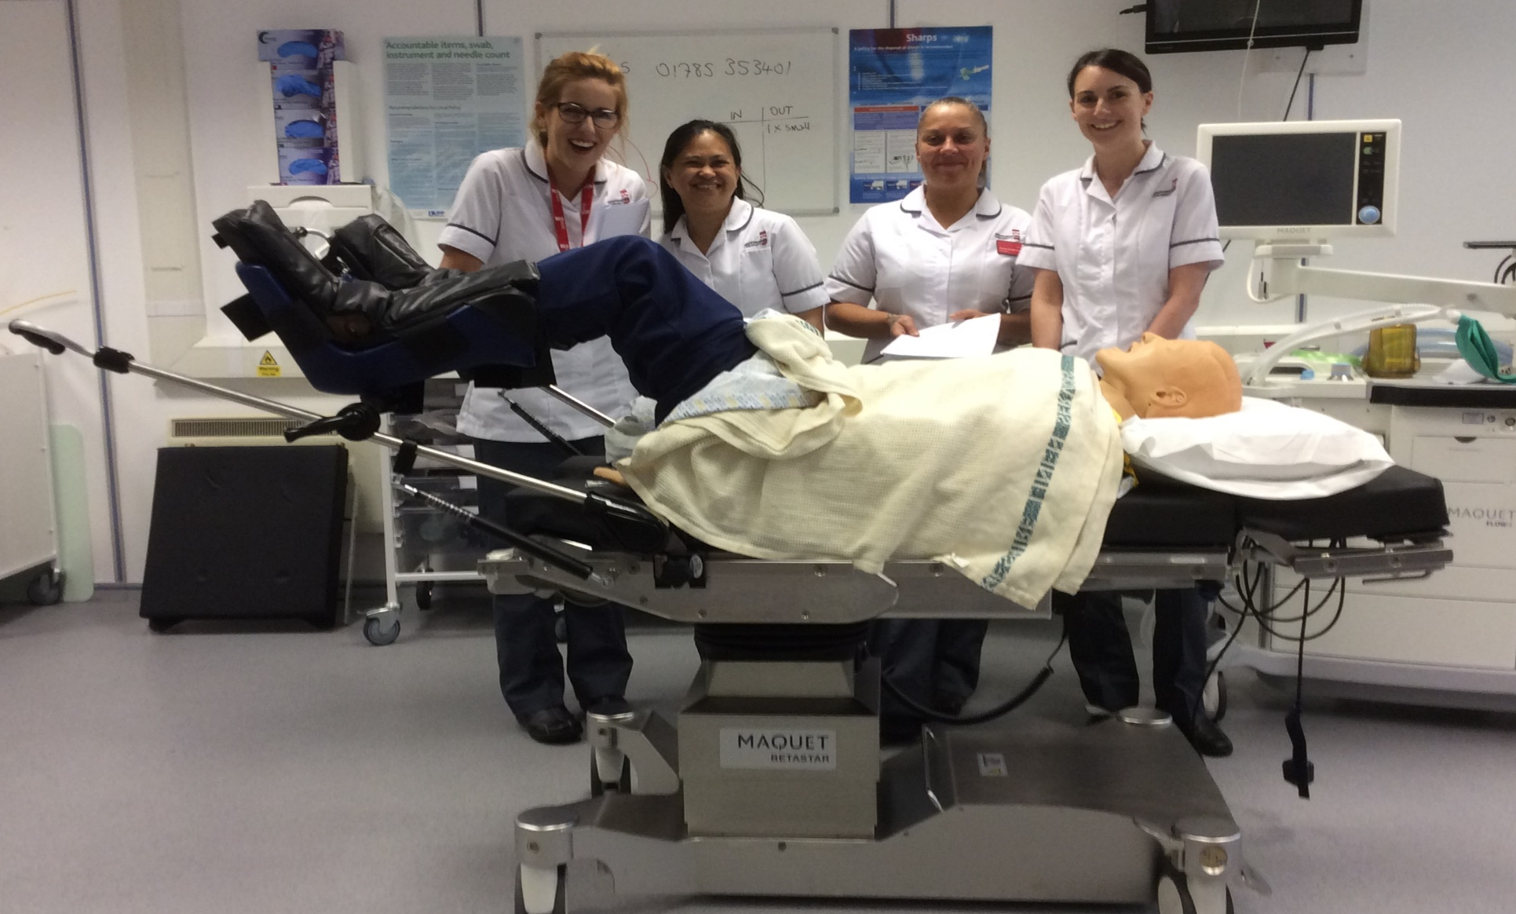


Innovating: integrating technology into teaching and learning with Operating Department Practitioner students.
Angela Woolliscroft. Staffordshire University, Faculty of Health Sciences.
INTRODUCTION
TEACHING METHODOLOGY
EVALUATION
FUTURE DEVELOPMENTS
The majority of students today are conversant with technology, such as social media, internet and email, and consider them a fundamental part of everyday life. Integrating these technologies into teaching and learning should encourage or enhance learning, providing flexible, student-centered approaches. It should incorporate adult learning theory with its focus on self-directed learning and developing skills of inquiry.
The choice of teaching methods needs to be consistent with the intended learning outcomes. In the training of healthcare professionals, active learning can engage students in the learning process, encouraging learners to move beyond the acquisition of underpinning theory and knowledge, to the transfer of knowledge and skills to the patient environment. Learners are encouraged to use the activities to construct their own knowledge base, and are assessed putting this underpinning knowledge into practice (Biggs and Tang, 2011). Lecturers should be encouraging students to achieve their learning outcomes by creating an environment that encourages students to perform.
The incorporation of simulation into the curriculum can provide the link between theory and clinical practice, giving students the opportunity to learn clinical and non-technical skills in a safe environment. The introduction of simulation, in conjunction with other technologies, can enhance traditional teaching and learning, resulting in greater student engagement and lessen student attrition (Cooper and Robinson, 2000).
Advance information and resources: Prior to the sessions information was put onto the VLE, consisting of the session PowerPoint presentation, specialist worksheets, and relevant journal articles. This formed the pre-brief, and gave students the context for the sessions. Students were encouraged to access the information before the sessions. They had two weeks after each session for completion of the worksheets.
Classroom learning: The sessions started with the didactic delivery of a review of the anatomy and physiology involved; background information relating to the surgical specialty, for example gastrointestinal, gynaecological or minimally invasive surgery; and a discussion of minor surgical procedures relevant to the speciality. Resources used included PowerPoint presentation, photographs, and videos of surgical procedures. Students were given a brief for the group work, and they had the opportunity to clarify the expectations of the activity.
Team preparation: At the beginning of their module the students had been randomly allocated into five groups. These groups had a mix of operating theatre experience, ranging from zero to a number of years working as a Health Care Support Worker. Students worked in their groups to prepare a short presentation about a specified surgical procedure using supplied information packs and electronic resources.
Interactive presentation: In the theatre simulation suite, each group delivered a presentation to their peers which included details of the underlying pathophysiology, the surgical procedure, and the benefits, risks and complications for the patient. Each group was required to position the Simulation manikin (SimMan) on the operating table for that specified surgery. Correct moving and handling techniques had to be demonstrated, and the correct use of the operating table and positioning attachments.
Verifying understanding: The lecturer verified understanding by asking questions, and enriched the learning experience by including examples from clinical practice which encouraged the students to think about the multifaceted role of the scrub practitioner. The other students were also encouraged to ask questions, and to clarify understanding. Students also completed a worksheet post session to enable assimilation of information.
Evaluate session: Students were asked to evaluate the session by completing a questionnaire. This focused on learner satisfaction, perceived gain in knowledge, and engagement in learning.
Students were asked to provide feedback on their engagement with the online materials, the classroom session, and the group activity and presentation. They were asked to evaluate the positive aspects of the sessions and suggest areas for development. They were also asked to indicate when they had accessed the session material in the VLE – prior to or after the session. Written feedback was provided and subjected to content analysis based around emergent themes from the student responses (Basit 2010).
All the students (n = 21) agreed that the outcomes for the session were made explicit and that these were achieved. All the students accessed the learning materials on the VLE, 81% prior to the session, with 70% of students accessing the PowerPoint presentation and session worksheet, but only 25% accessing the journal articles. Background reading before the didactic session can help orient students to the learning material (Light et al, 2014). This ‘pre-briefing’ phase is essential for meaningful application of the information in the group activity in preparation for the presentation and simulation (Brackney and Priode, 2015). Students that engage in reading the journal articles are also developing their research skills and preparing for their literature review in the next module.
Working in small groups work can help students to construct deeper meaning, enhance critical thinking skills, and promote social development (Cooper and Robinson, 2000). As the groups developed it was observed that all the students were contributing, either by carrying out additional research on the internet for information on the surgical procedures and underlying pathophysiology, or by preparing the narrative for the presentation. This self-directed learning can lead to students who not only develop this deeper understanding, but who are also more likely to want to demonstrate these abilities and skills in practice (Timmins, 2008).
Students actively participating in the learning process are found to have a higher satisfaction, and demonstrate long-term knowledge retention. As well as engaging in peer learning (Boud et al, 2001), the student ODPs also developed their presentation skills, an important aspect as the summative assessment for this module is a seminar presentation. Due to the learning support agreements (LSA) in place, there was no requirement for all students to speak during the presentation. In reality, all students participated.
Using simulation in the theatre suite also allowed the students to practice skills in a safe environment. The resulting experiential learning is thought to form a bridge between theory and clinical practice (Inch, 2013).
Course content: Accessing electronic student records, and further utilization of online resources such as quizzes. Use of qualtrics format for feedback.
Engaging students: Continuing to develop this blended learning, using technology and traditional teaching, to support deeper and more meaningful learning for the students. To develop the use of Wiki, which has great potential for facilitating self-directed learning.
Communication: Developing the use of discussion boards and blogs, following the limited success of using a class blog as an ice breaker at the start of the programme. To consider the use of podcasts to supplement the course material, and to assess student learning by students creating their own (Roberts, 2008).
Learning: To consider the development of an e-portfolio to enable students and tutors to follow student progress and development. This would include assessment documents, critical reflections, practice outcomes, and case logs.
Simulation: To continue to develop high-fidelity simulated learning to support the achievement of learning outcomes in practice.
REFERENCES
BACKGROUND
Basit, T. N. (2010) Conducting Research in Educational Contexts. London: Continuum International Publishing Group
Biggs, J. and Tang, C. (2011) Teaching for Quality Learning at University. (4th edition) Maidenhead: Open University Press
Boud, D., Cohen, R. and Sampson, J. (2001) Peer Learning in higher Education: Learning from and with Each Other. Sterling: Stylus
Brackney, D.E. and Priode, K.S. (2015) Creating context with prebriefing: a case example using simulation. Journal of Nursing Education and Practice. 5 (1) p129-136
Cooper, J.L. and Robinson, P. (2000) The argument for making large classes seem small. New Directions for Teaching and Learning. 81 p5-16
Inch, J. (2013) Perioperative simulation learning and post-registration development. British Journal of Nursing. 22 (20) p1166-1172
Light, G., Cox, R. and Calkins, S. (2014) Learning and Teaching in Higher Education: the reflective practitioner. London: SAGE
Roberts, M. (2008) Adventures in Podcasting. PS: Political Science and Politics. 41 (3) p585-593
Timmins, F. (2008) Take time to facilitate self-directed learning. Nurse Education in Practice. 8 (5) p302-305
Course content: The role of the Operating Department Practitioner (ODP) covers three core skills: anaesthesia, surgery, and post-operative recovery. Student ODPs undertake a two year Diploma (HE) in Operating Department Practice, developing underpinning theory and clinical skills leading to professional registration with the Health and Care Professions Council (HCPC). The surgical practitioner role is multifaceted, and challenging to teach without physically doing it! Historically lectures consisted of verbal descriptions supported by photos and video. Module evaluation highlighted that students were not engaging fully. There was minimal use of the virtual learning environment (VLE), with only sessional learning materials uploaded. However, recent developments included the setting up of an electronic reading list.
Communication: This was mainly an oral medium, although one-to-one email exchanges took place. A tentative step into using technology at the start of the current programme included the introduction of a class blog to encourage students to get to know each other. This had limited success.
Learning: Students currently submit paper-based clinical practice outcomes and portfolios, however they submit assignments electronically.
Simulation: The recent introduction of high fidelity manikins into the theatre simulation suite has proved time intensive, but has resulted in positive student engagement. However their use has been restricted to specific sessions, and students do not have experience of interacting with them. This can cause anxiety about how they engage with the manikin.
FURTHER INFORMATION
Angela Woolliscroft – angela.woolliscroft@staffs.ac.uk
Lecturer in Operating Department Practice
Staffordshire University – 01785 353784

