Slide 1
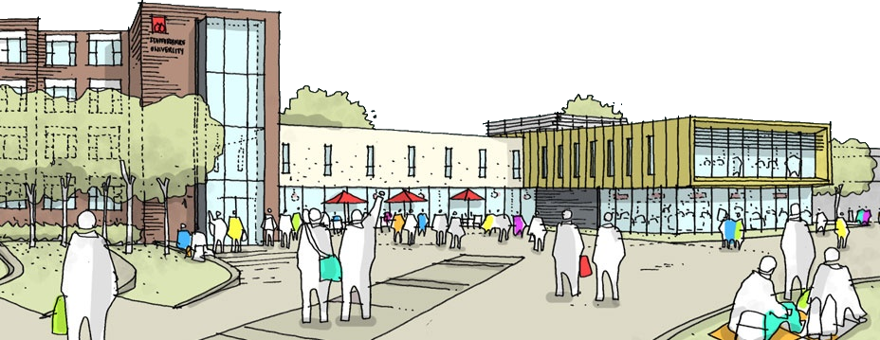
Widening Participation: Preparing Students of Diverse Backgrounds for Higher Education
Toby Lucas, Staffordshire University
Introduction
Literature Review
Research Method
Project Aim
This research project will aim to investigate what Staffordshire University (SU) is doing in order to encourage and support underrepresented students whom have the potential to benefit from Higher Education (HE). In particular this work will focus on how effective the SU (2013a) Step Up to HE University Foundation Certificate course is at supporting mature students towards a Level 4 qualification. The findings of this project will determine if there are any further actions the author can apply to their own practice in order to improve the level of support given to these students.
What is Widening Participation?
Widening Participation is the initiative to ensure “Everyone with the potential to benefit from higher education has an equal opportunity to do so, regardless of background, age, ethnicity, disability or gender.” (OFFA, 2013) some of these individuals are under represented within HE normally due to potential “barriers” (Gorard, 2007) that may discourage this type of student.
What is a Mature Student?
UCAS (2013) define a mature student as “any student aged 21 or over at the start of their studies” this definition will be used to determine what constitutes a mature student throughout this work.
What is Step Up to HE?
Step Up to HE is a Level 3 qualification offered by SU aimed at anyone over 18 years who is thinking about further study and may be unsure of where to start or what is involved. It provides them with a 10 week taster of University life in a supportive environment.
Rogers (2010) emphasises the importance of the initial stages of a learners first interactions within a Higher Education environment. These may be negatively influenced if the learner is directed towards independent study if carried out too early in their development process.
Mortiboys (2005) emphasises the importance of this strong start to a session as it sets the tone for the rest of the session. Mortiboys (2005) says that using the correct language encourages a learning “state” in students, this is particularly important at the beginning of the course “start as you mean to go on”.
In particular, the start to a session according to Mehrabian (1981) can be strongly dictated by body language (see Fig. 1), as such this can greatly impact a learners first impressions of HE.
In response to supporting “mature” students, Bamber (2008) conveys a two-way model titled the “process of change”, as a change in learner’s initial expectations of HE being an “alien” environment by addressing students specific “needs” of that learner.
Carrying out a case study, Bowl (2010) found of University preparation courses:
All tutors felt the need to protect mature students and stressed the importance of a “safe space” learning environment.
Emphasis on the importance of “Study Skills”
Access practitioners in Further Education colleges were less well placed to introduce their students to university culture.
“The campus-based model (of a university preparation course) is more likely to achieve a smooth transition” within mature students.
Primary research was carried out by using TheSIS to query
Staffordshire University’s Oracle database for all students whom
had enrolled to the Step Up to HE course over a 5 year period, for
academic year starting 2008-2012.
In addition to this further information was manually recorded from TheSIS for every student whom attended an interview for Step Up to HE during academic year starting 2012. All raw data was anonymised by assigning a new unlinked number to each of the 354 unique records before being recorded. Following this the data was analysed, compared and contrasted in Microsoft Excel®.
Fig. 2
Discussion of Findings
Analysis of Step Up to HE Students
70-80% of these learners are mature students (see Fig. 2), gender is typically balanced and a very strong proportion of students are locally based to the university, in the Stoke-on-Trent area (see Fig.3).
Step Up to HE Student Success
Out of 98 students offered a place (on Step Up to HE, in academic year 2012) 54 successfully completed both modules of the course (see Fig. 4) and 44 students withdraw or never start the course.
The majority of students continue to attend and pass the course.
Step Up to HE Progression
Out of 54 students, 42 choose to and are offered a place to study at Level 4 once successfully completing the course (see Fig. 5). A minority (12) of these students take another path. This includes FE college, work and most likely includes students who will return to HE at a later point. This data is rapidly changing as students try clearing or choose an alternative routes. (SU TheSIS, 2013)
Fig. 1
Fig. 3
Impact on Teaching & Learning
According to the Office for National Statistics (2012) Stoke-on-Trent is the eighth poorest area in the country with 27.8% of children being classed as in poverty in 2010. With 70% of students living in Stoke-on-Trent it can be expected that there will be a number (Approx. 19.5%) of students from this type of background. From authors own experience this financial constraint can impact on attendance and ultimately learning.
A majority of the Step Up to HE cohort is constructed of mature learners, as such they may have been out of education for some time, if this is the case HE is likely to be an “alien” environment (Bamber, 2008) in order to retain students it is important to ease them into this environment (Rogers, 2010) to ensure they are not negatively influenced. Some never start the course it might be that their needs are not met (Bamber, 2008) at an early stage.
Fig. 4
Actions for Own Practice
In order to ensure the continued success of Step Up to HE it is essential:
To support learners individual “needs” (Bamber, 2008) it is felt that cohort size should be reduced to allow students access to tutor support, this should be monitored to see if drop out figures reduce.
At interview students should be provided with tutors contact details and number of students “never started” will be monitored.
The importance of Study Skills, is acknowledged, to continue to include additional Information Literacy workshop.
The course is continued to be offered as “campus-based model” (Bowl, 2010) using the shared facilities of the university.
To ensure funding is in place to make sure the course remains free and organise class presentations on student finance with money doctors allowing learners to see studying a degree can be affordable.
Fig. 5
Illustration
(Staffordshire University, 2013b)

