Slide 1
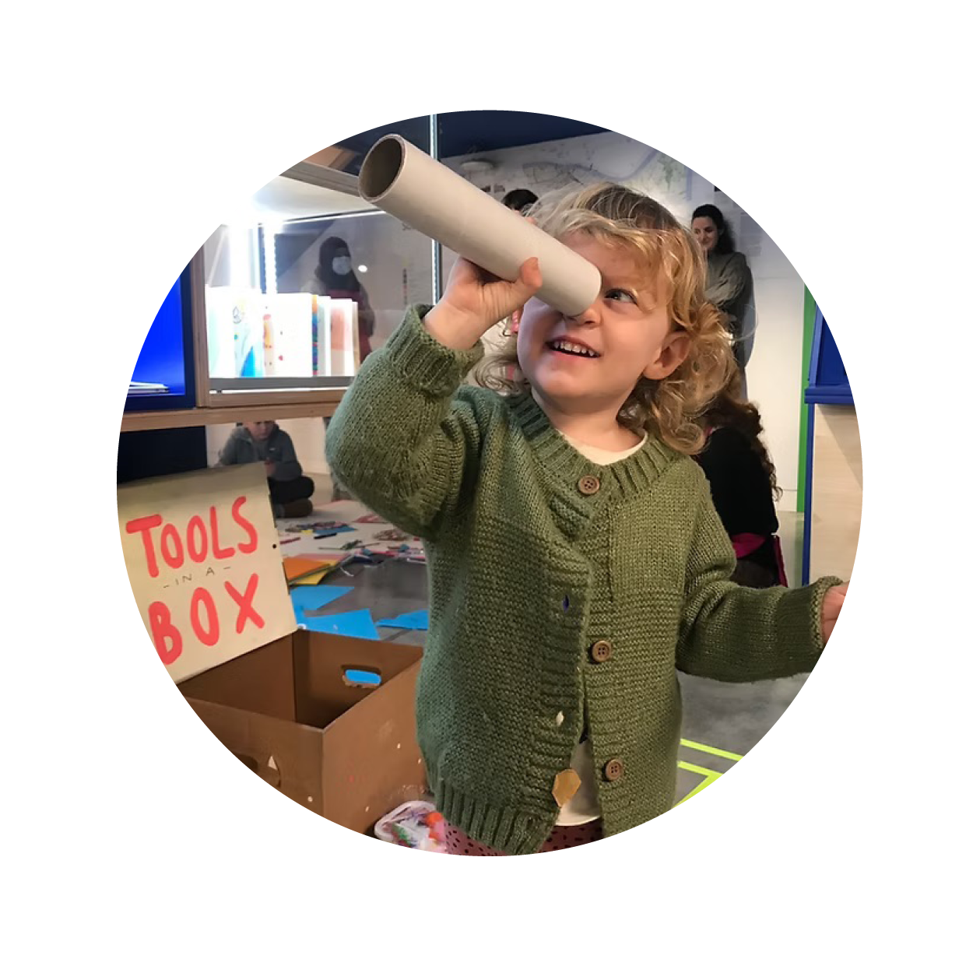
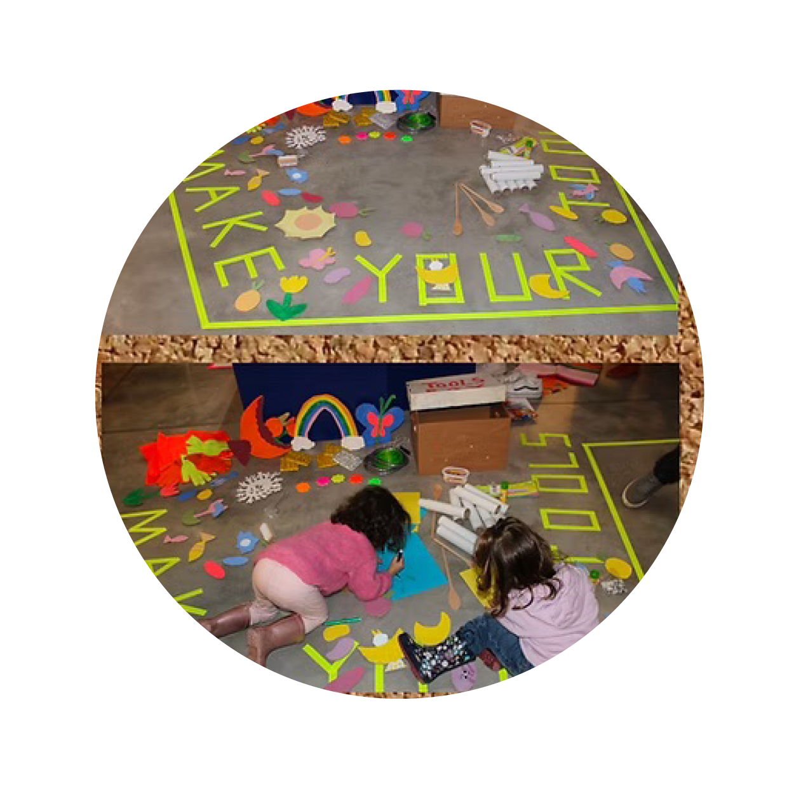
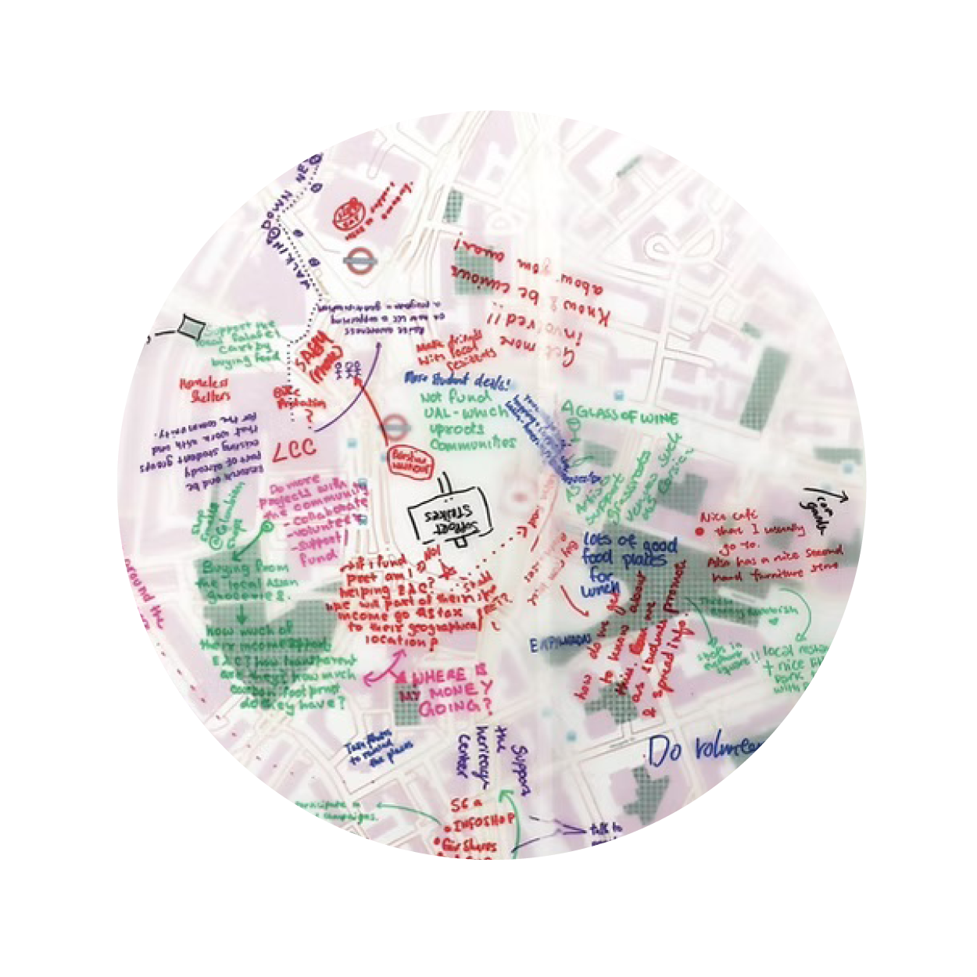
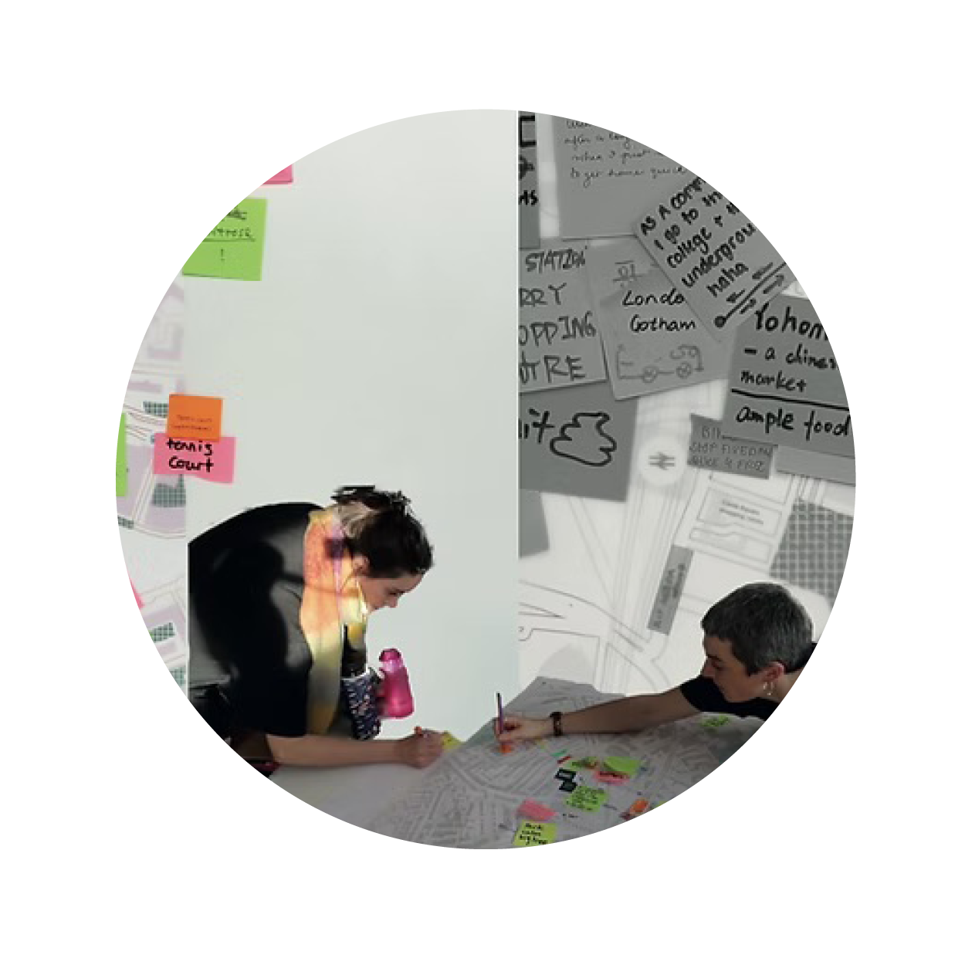
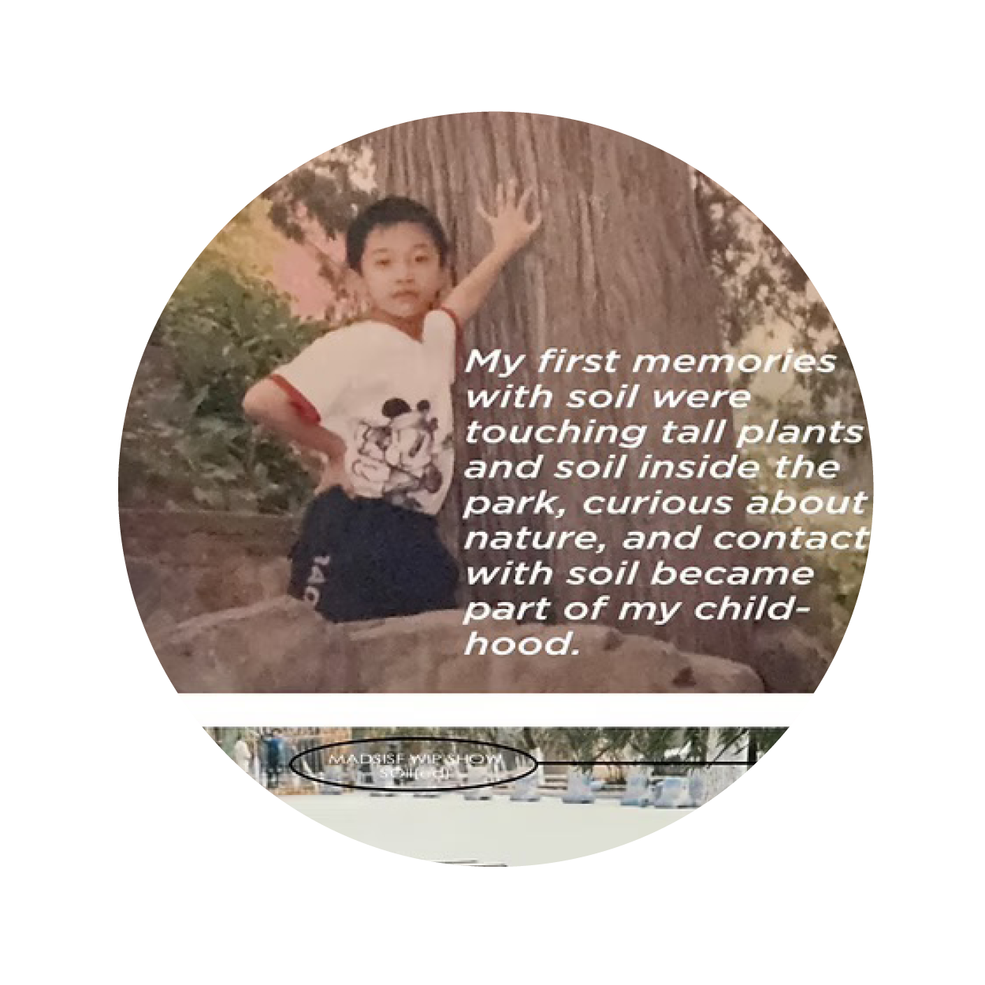
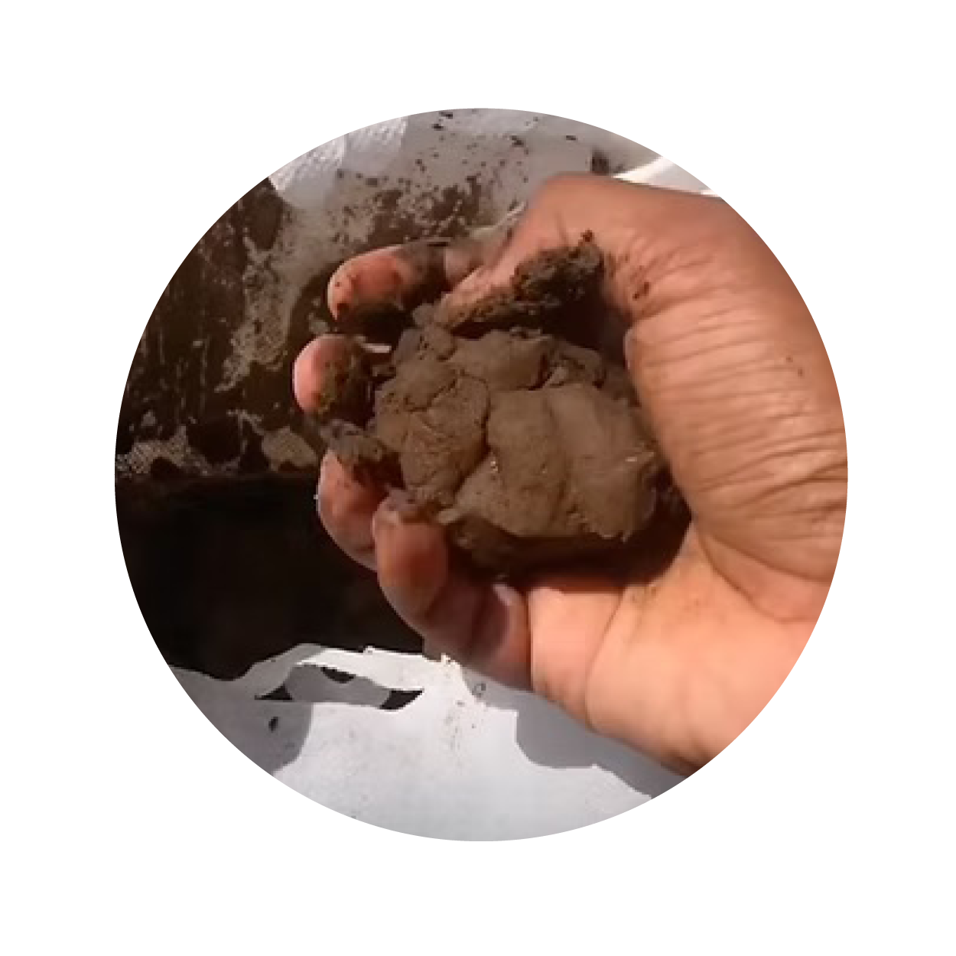
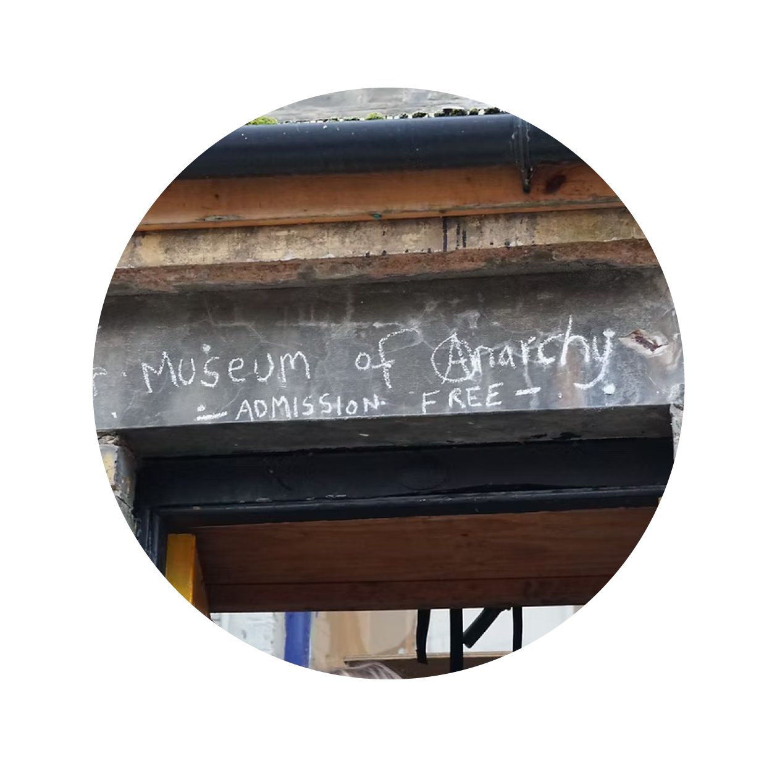
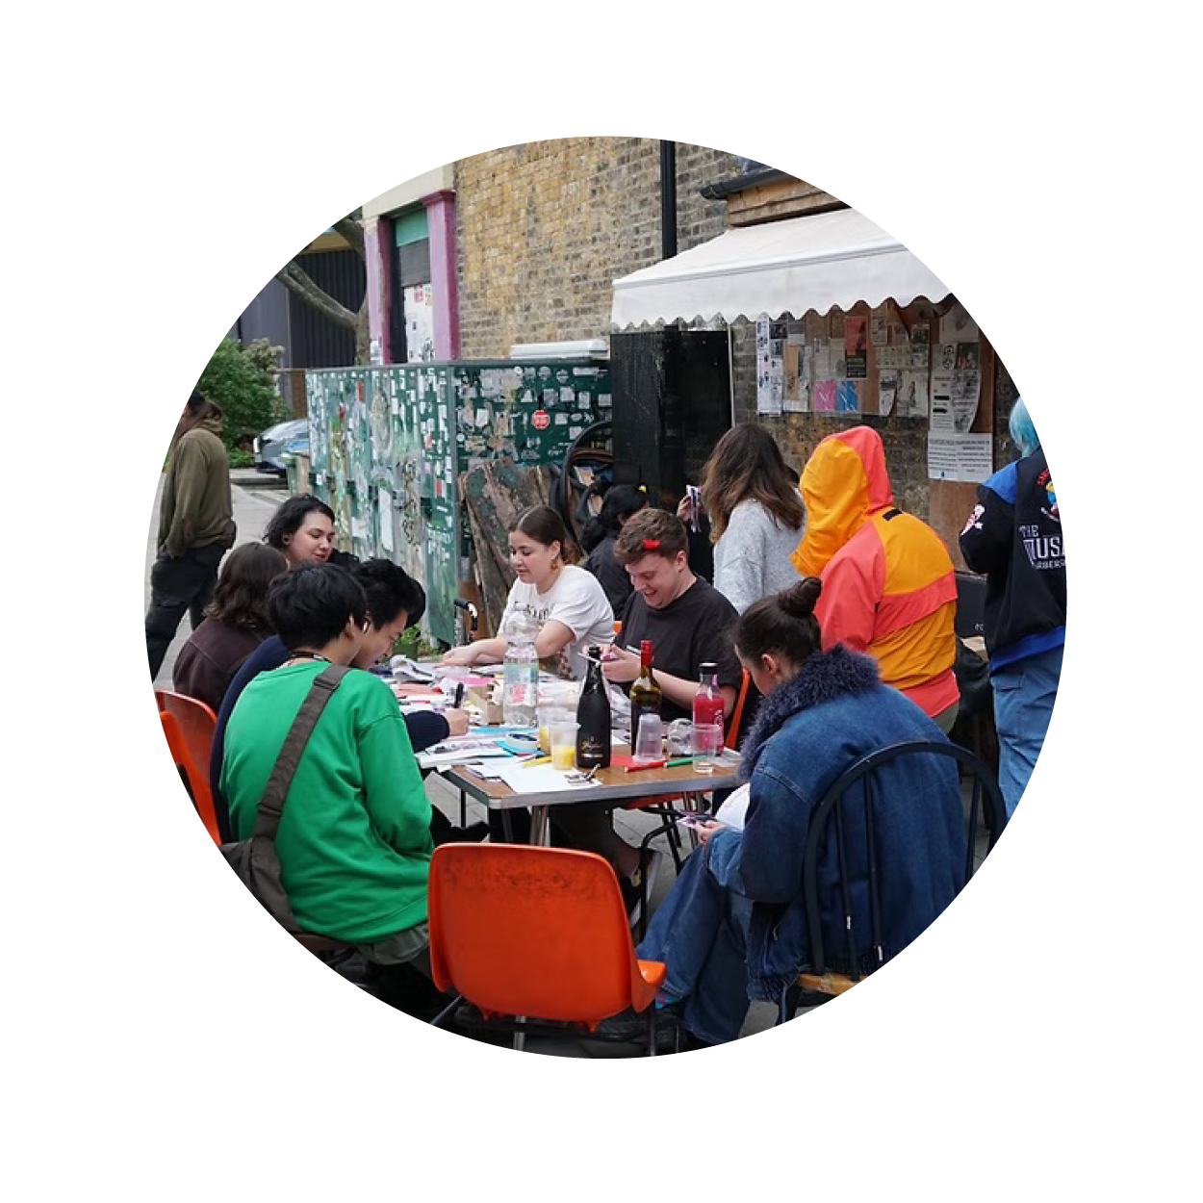
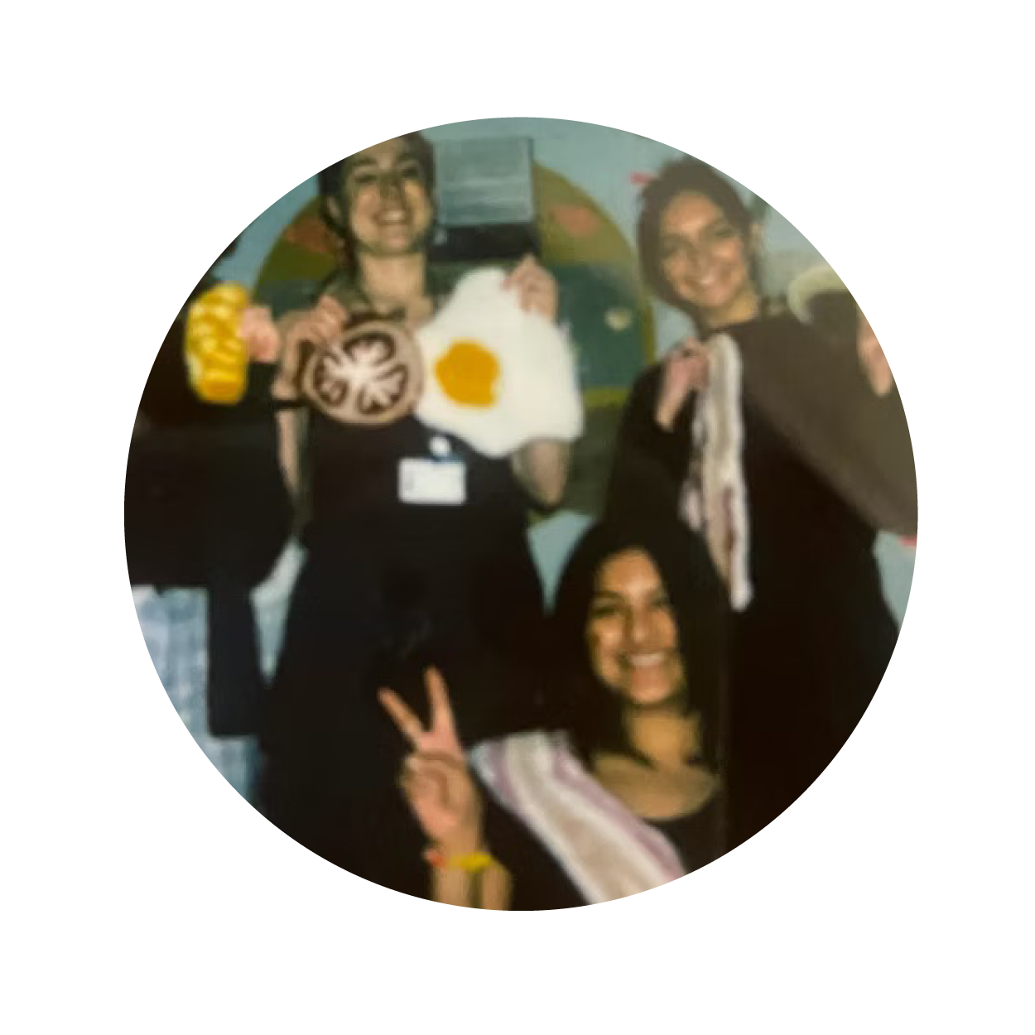
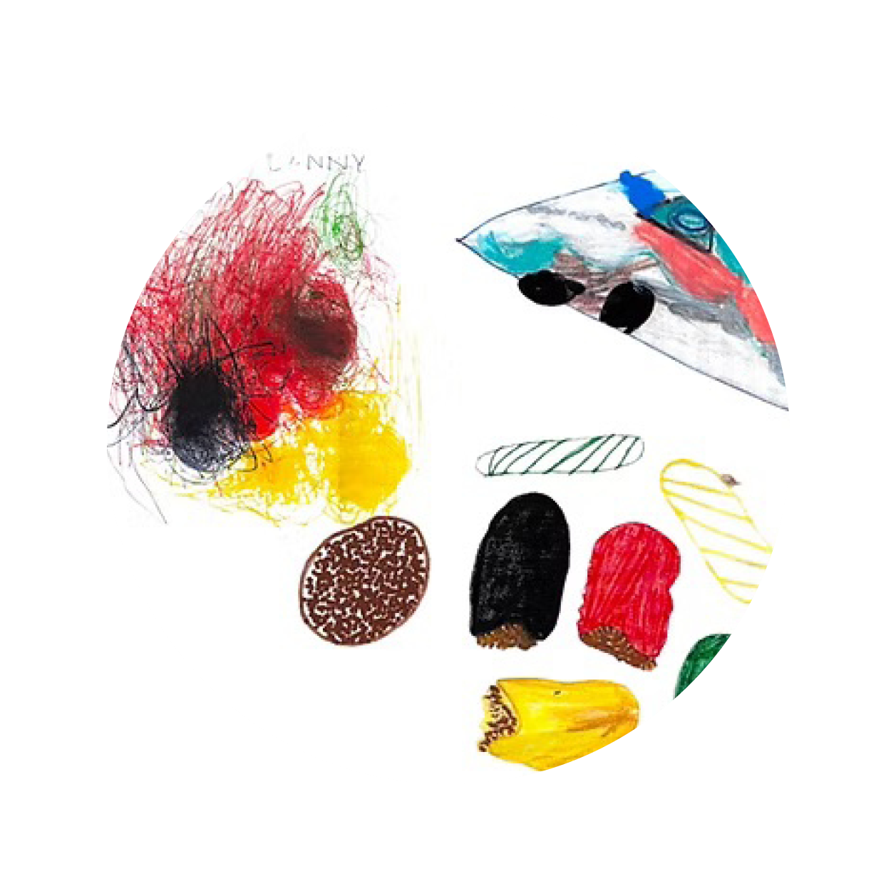
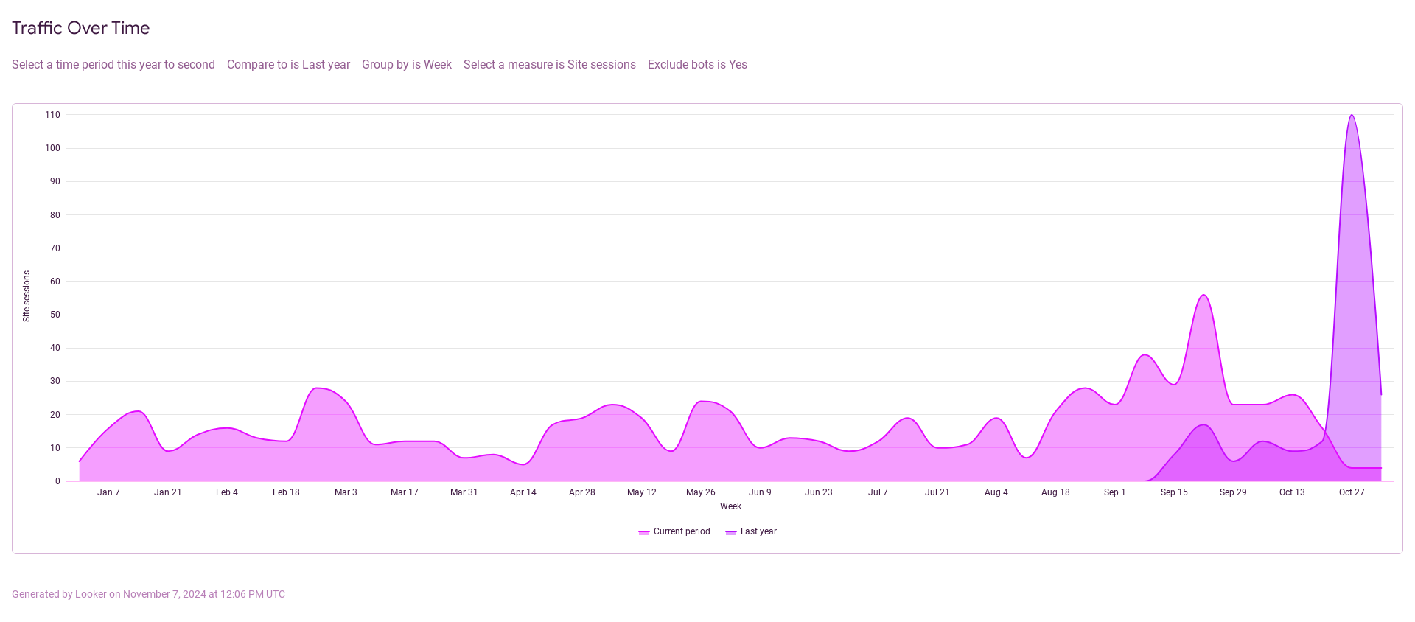
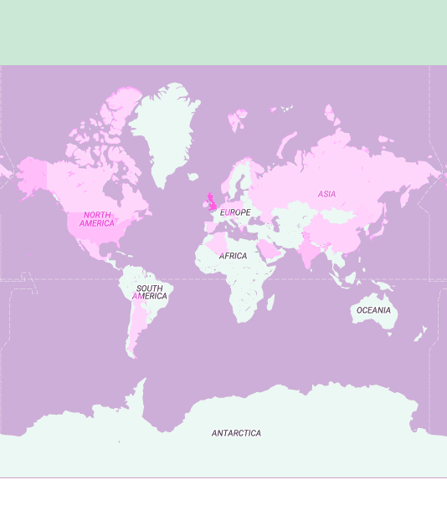
Autonomous Syllabus
An open access curriculum for
eco-social design practice
Curiosity w/ Walworth Library
Mapping w/ The Remakery
Soil Stories w/ Land in our Names
Nonsense @ 56A Infoshop
Eating w/ Camberwell Incredibles
Anna Schlimm (Anna a.schlimm@lcc.arts.ac.uk) and Ella Britton (e.britton@lcc.arts.ac.uk), London College of Communication, University of the Arts London
Introduction & context: who can access learning?
Methods and discussion:
Opening up our curriculum online
Results & conclusion – the impact: data, feedback & reflections
The cost of accessing higher education is increasingly prohibitive. But central to our course ethos is the belief that finding answers to complex global questions cannot be in the hands of the privileged few. To enable the co-construction of new possibilities for the future and create a space for collective imagination (brown, 2017), we created an open access version of our curriculum in September 2023 called the Autonomous Syllabus.
Our intention was to ensure that the creative tools and knowledges for social and ecological justice covered on our course are accessible to everyone. To do so for different audiences, we developed three strategies:
An online resource to share our curriculum every week to reach a global audience (Swartz & Lessig, 2016).
A local knowledge exchange initiative with organisations in the London borough of Southwark, to grow more mutualistic networks (Kimmerer, 2013) where our campus is based.
A living archive (Mattern, 2022) built by students to share resources and projects over time within and beyond the UAL community of practice.
Our first step was to create an online version of our taught curriculum, inspired by the open access movement (Swartz & Lessig, 2016). It is structured by unit and makes all course materials – including slides, workshop materials and readings – accessible week-by-week. In theory, anyone in the world with an internet connection can take part in the course this way. The website data shows engagement across the globe (see map below).
We collected data through the website, calls for feedback and conversations with students and colleagues. We have learnt:
People from all over the world are accessing the site regularly, on average we are seeing 10-30 people using the site a day with peaks of up to 110 people.
Students and staff shared that they use the site across other BA and MA programmes to bring eco-social content into their own learning.
Academic staff in other universities have shared stories of using this site to inspire their own development of open-source resources.
Students reflected on their knowledge exchange experiences, and shared how activating and collaboratively developing their course curriculum influenced their creative practices and position as designers and researchers:
"Spending time with the anarchist archive 56A Infoshop and helping them understand our process really helped build trust. Now we see they are keen to work with us."
"We built knowledge of how mapping could be used as a tool for solidarity."
"Collaborating with soil made us reflect on the extractive nature of research and how we interact with our environment."
"Working with Camberwell Incredibles deepened our understanding of the challenges neurodivergent individuals face in a world not designed for them."
2. Exchanging knowledges with local communities
In January 2024, we received funding to explore how our course could be shared with and enriched by situated knowledge exchange with local communities. We collaborated with five local organisations, starting from key concepts in the curriculum:
'How might power be redistributed by asking children to teach us about curiosity and care?', with the Walworth Library.
How might mapping the pluriversal knowledges within local neighbourhoods entwine with our studio practices?', The Remakery.
'How might the more-than-human species of Southwark host our unlearning?,' with Land in our Names.
'How might nonsense become a methodology in our learning and situated knowledge exchange?', with 56A Infoshop.
'How might the embodied nature of making and exchanging food build connections without words?', with the Camberwell Incredibles.
Over 10 weeks, five very different and lively projects developed. Some of them have led to lasting relationships and collaboration, and bear testament to the value of situated knowledge exchange.
Inspiration: radical and open access education
The ethos of the Autonomous Syllabus was inspired and informed by a range of people and projects that make learning and participation in knowledge creation accessible in different ways. Our case studies included:
The history of the open access movement, including
Aaron Swartz's activism > We can escape the paywall! (Swartz, 2016).
Open access Ivy League university courses in the US
> Our material could be available online!
Shannon Mattern's open access curriculum (Mattern, 2022).
> There are very simple ways to share our knowledge!
The Anti University and School of The Damned
> There are radical initiatives self-organising and sharing resources!
Ella Britton's project Collective Design School at the V&A
>You don't have to be an expert to teach – we can redistribute epistemological power!
3. Working with students to create an archive of learning
Site traffic over time
Locations of site access
Over the past 6 months our graduating students have taken an active role in the nourishment and maintenance of the online syllabus. They have catalogued an expansive library of resources, beyond the material covered in class, in the 'living archive' section of the website.
They are also working with alumni to create an archive of all past projects developed on the MA, so that future students and external learners can build on each other's research, rather than starting from square one.
References:
Mattern, S. (2022). Cinema + Media Studies Theory and Methods https://wordsinspace.net [accessed 11 Dec. 2023]
Kimmerer, R, W. (2013). Braiding Sweetgrass: Indigenous Wisdom, Scientific Knowledge and the Teachings of Plants. Minneapolis, Minnesota: Milkweed Editions.
brown, a, m. (2017). Emergent Strategy. Chico, California: AK Press.
Swartz, A. and Lessig, L. (2016). The boy who could change the world :
the writings of Aaron Swartz. London: Verso.
Disclosure Statement: All materials included in the poster represent the authors’ own work and anything cited or paraphrased within the text is included in the reference list. This work has not been previously published nor is it being considered for publication elsewhere. There are no conflicts of interest that might have influenced the authors in reporting their findings completely and honestly.

