Slide 1
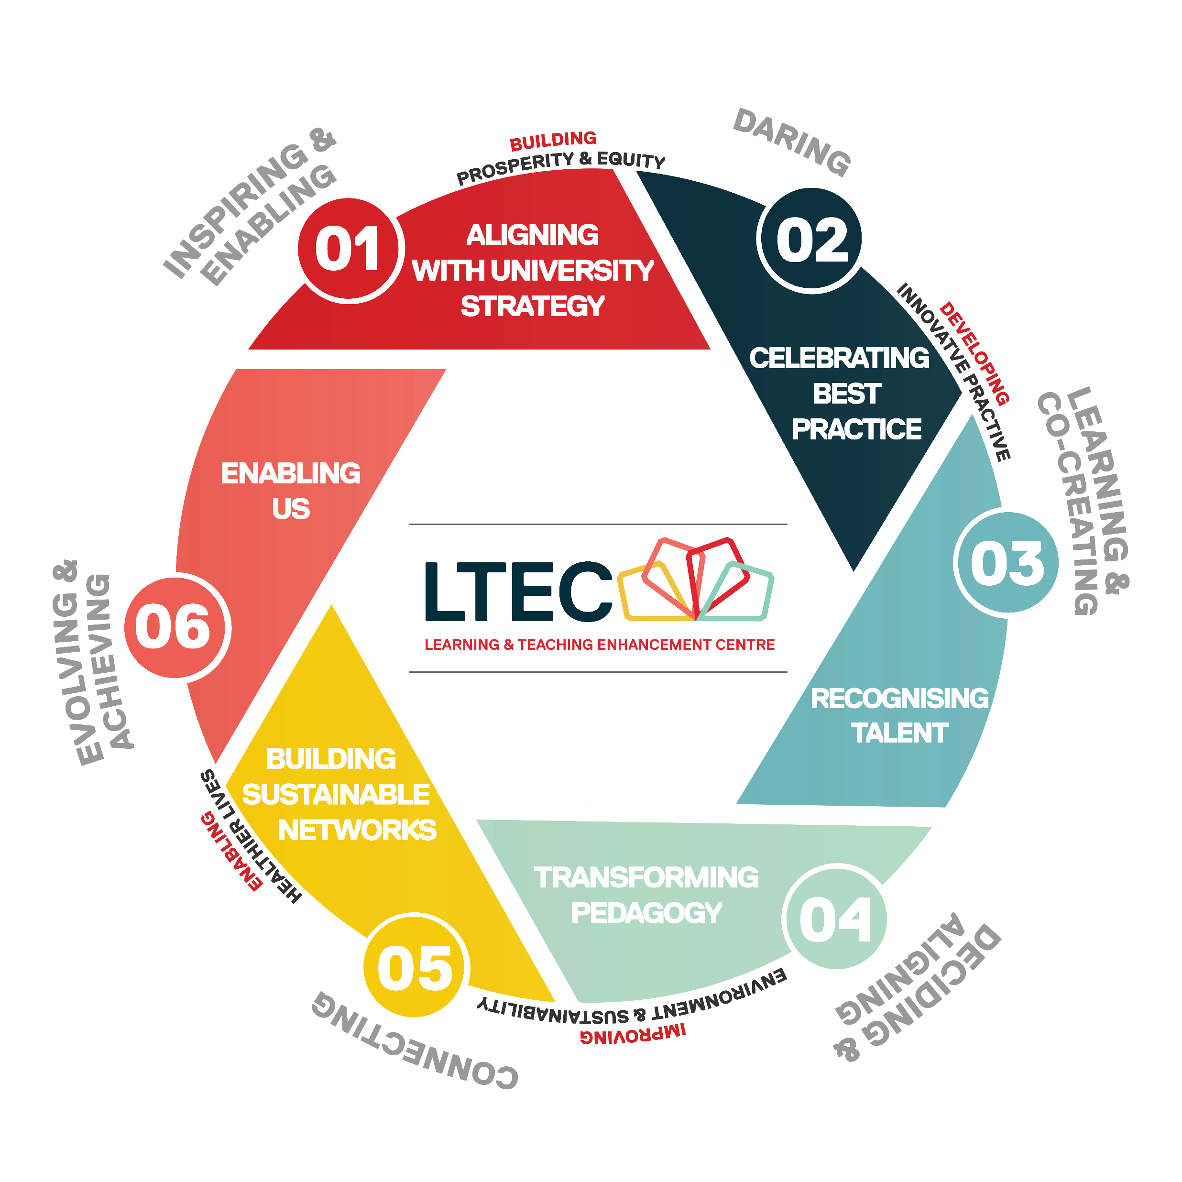
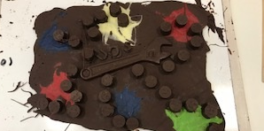
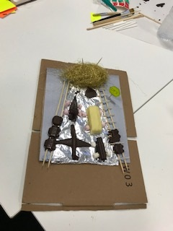
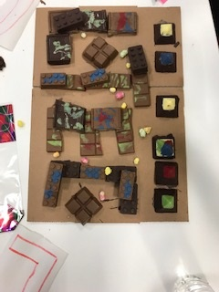

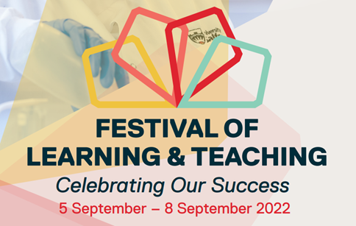





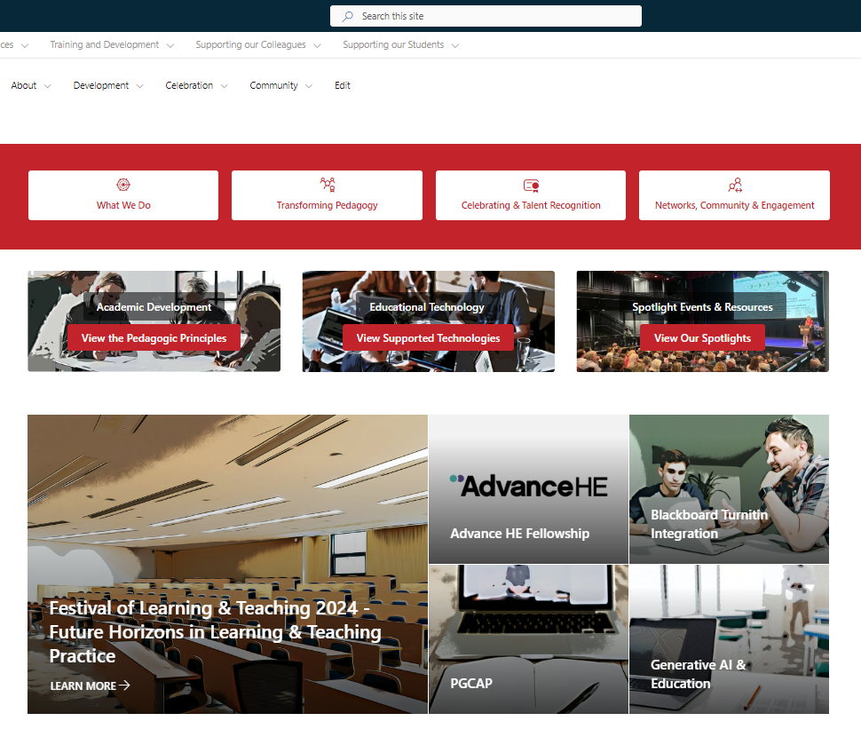


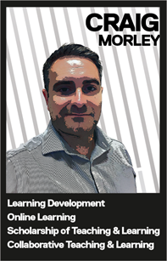
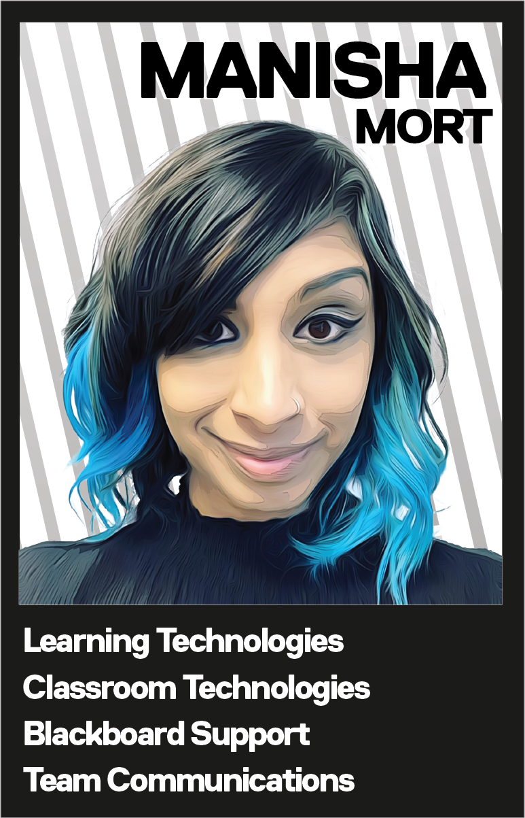
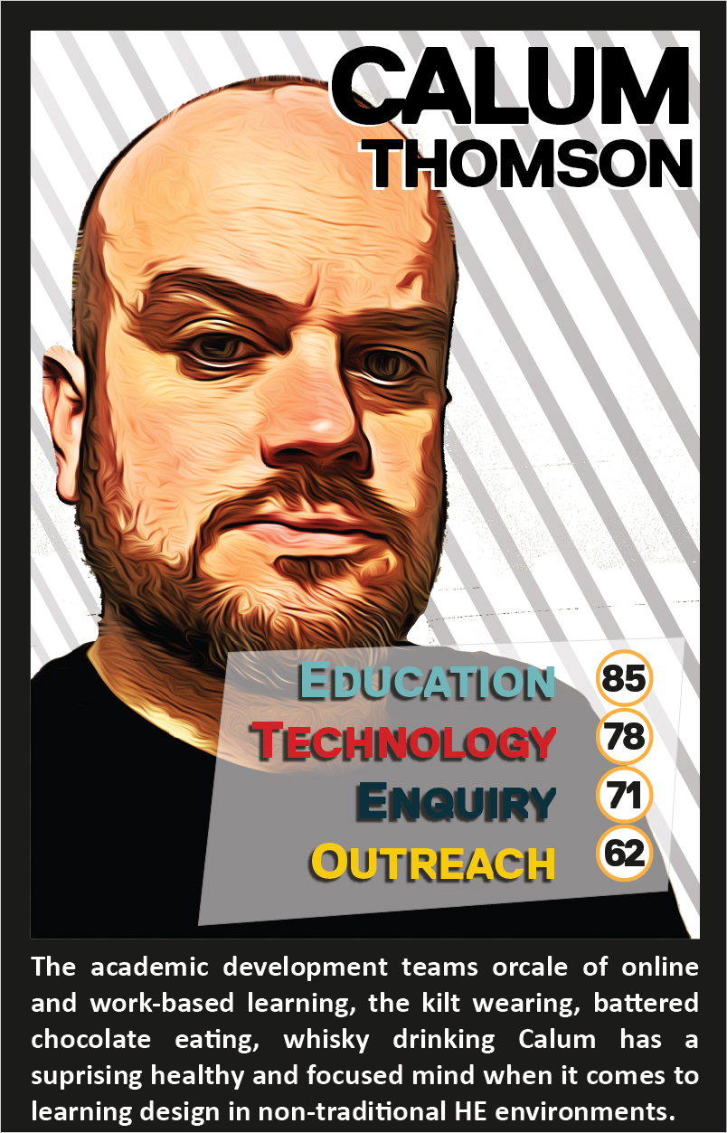
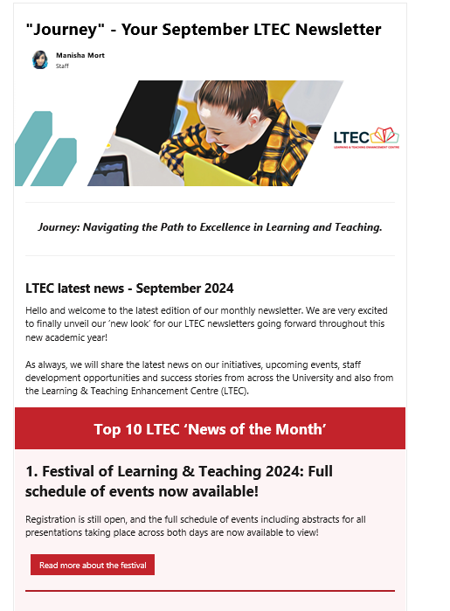
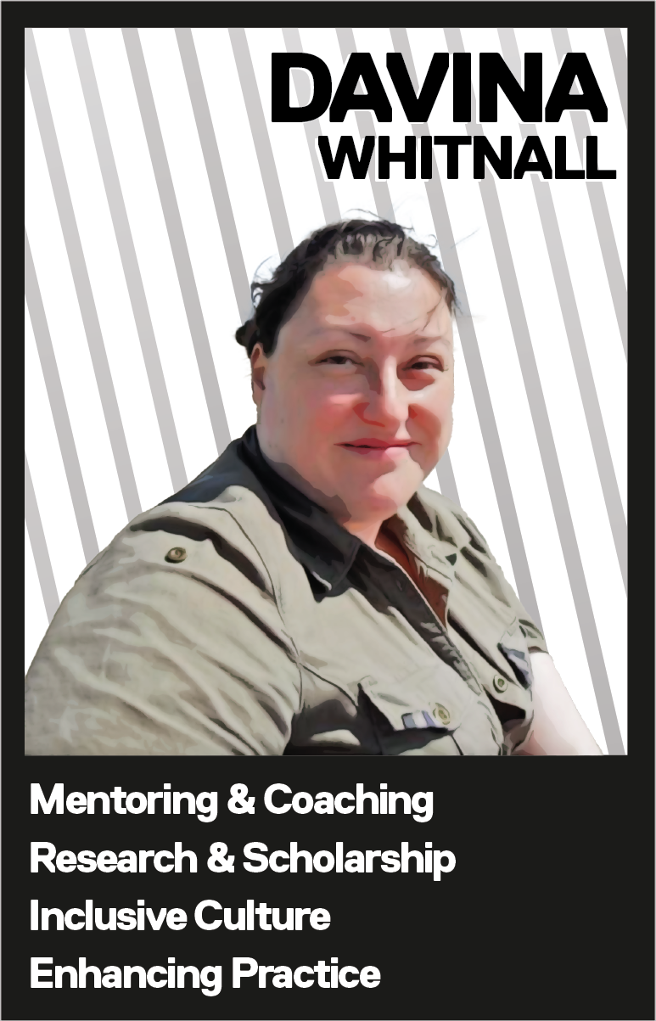


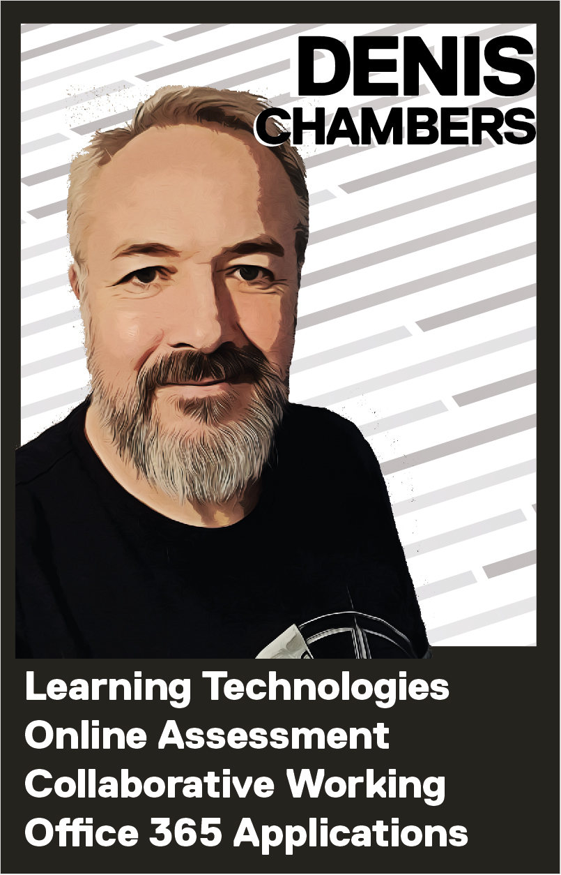
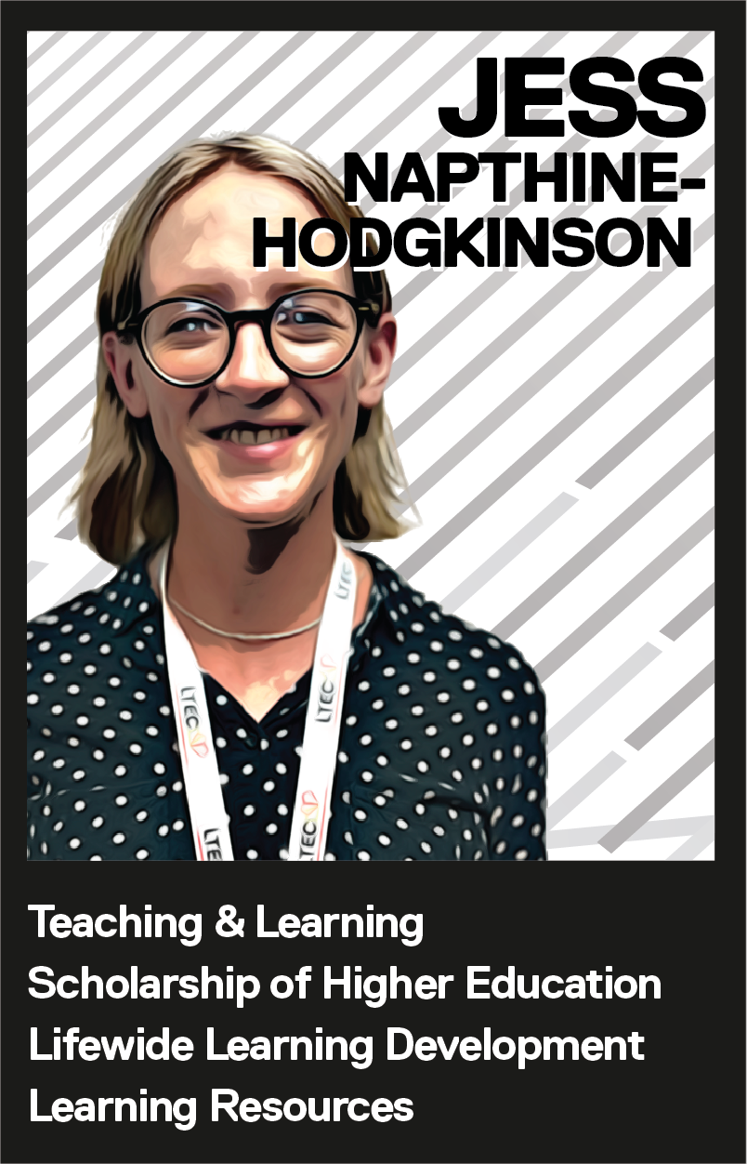
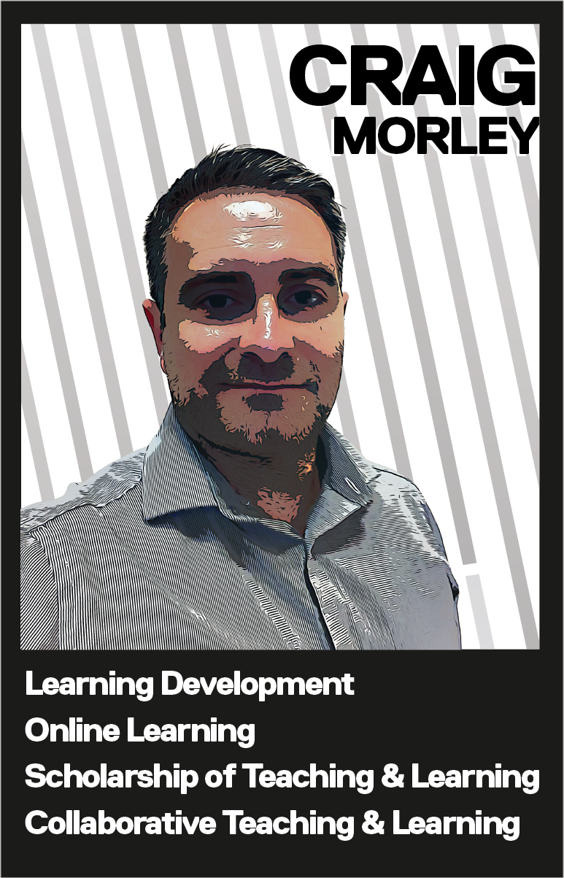
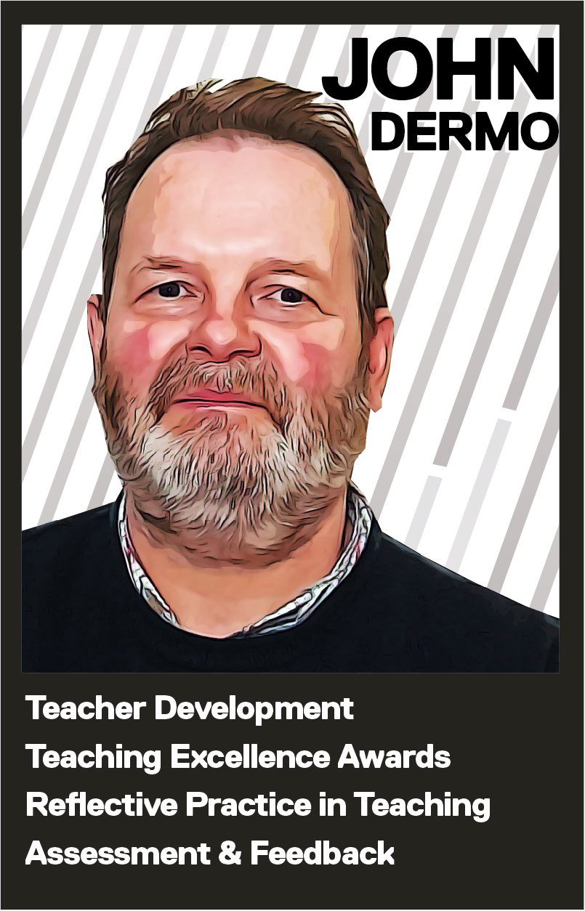
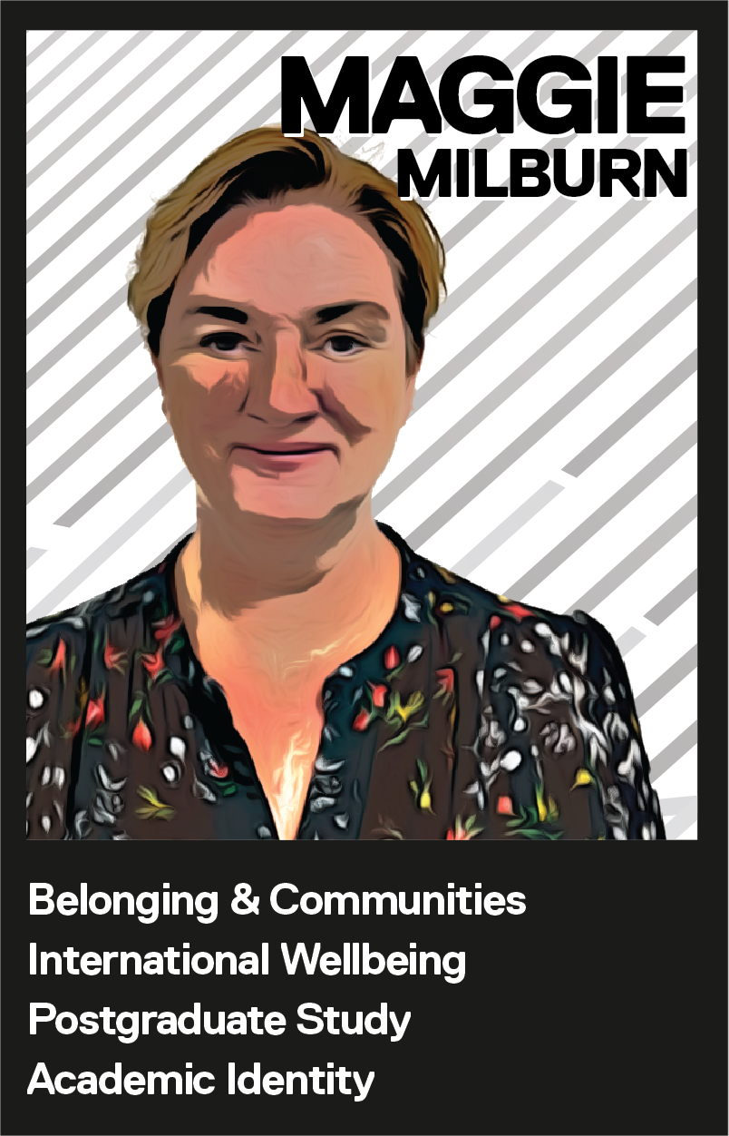
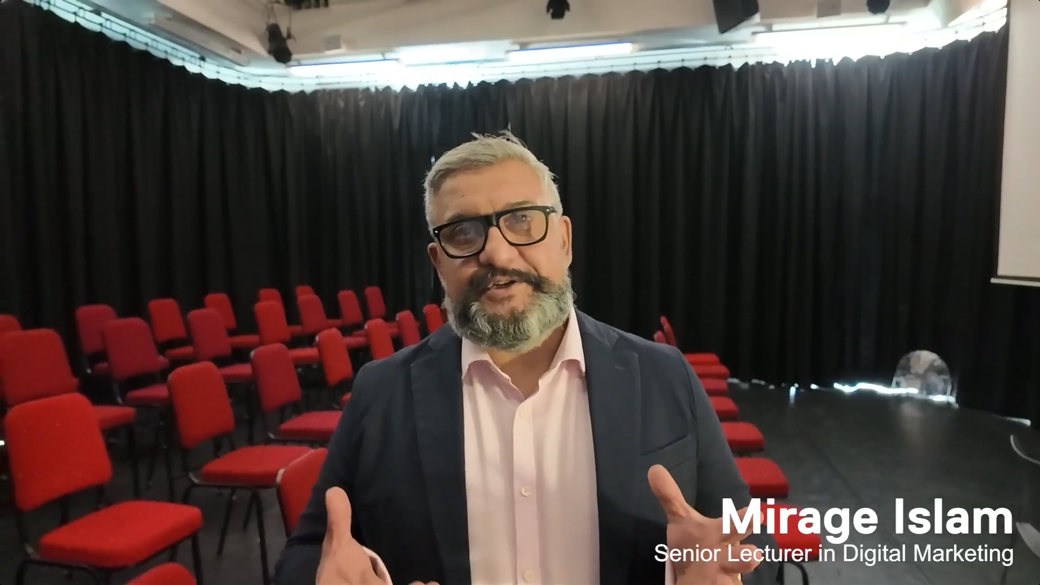
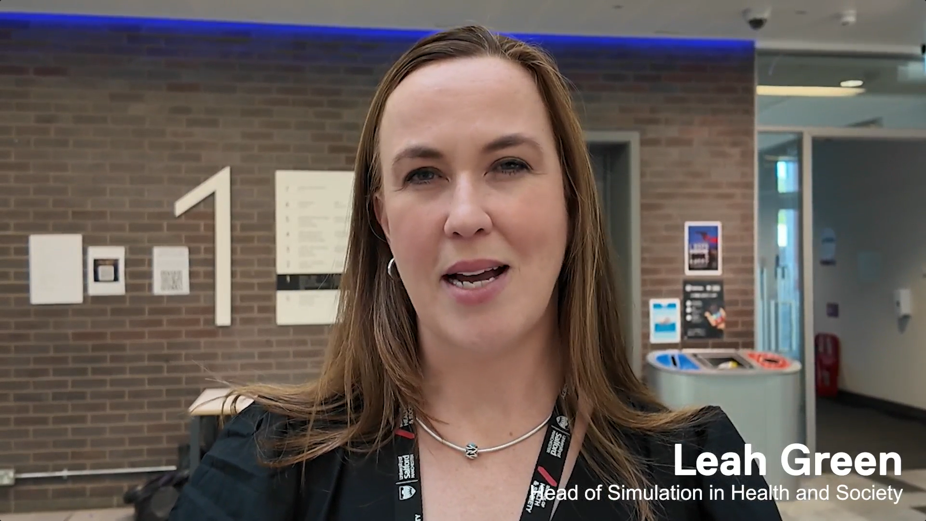
Prof Jess Power - Associate Pro Vice Chancellor Learning and Teaching Enhancement
Dr Calum Thomson – Higher Technical Skills Lead
Davina Whitnall – Equity, Diversity and Inclusion Lead
Learning & Teaching Enhancement Centre,
University of Salford. Contact: ltec@salford.ac.uk
All materials included in the poster represent the authors’ own work and anything cited or paraphrased within the text is included in the reference list. This work has not been previously published nor is it being considered for publication elsewhere. There are no conflicts of interest that might have influenced the authors in reporting their findings completely and honestly.
Rebranding Learning & Teaching at the University of Salford:
Building a creative community to support academic practice.
Authors
Disclosure
‘Academics in higher education operate within a range of academic cultures, balancing competing priorities of teaching, research and service… …it is of paramount importance to reduce academics’ barriers to enhancing teaching quality in order for them to engage in critically reflective teaching practice.’ (Carbone et al, 2019)
‘Creating brand associations linking emotions and feelings can strengthen loyalty, increase differentiation, and drive engagement.’ (Chea, 2024)
Essential to the LTEC brand:
Placing LTEC at the centre of our ‘6 strategy pillars’, as well as including institutional priorities and behaviours.
The overall image is conceptualised around a camera lens to emphasise our focus, perspective, clarity, adaptability and depth within the university.
Creative approaches to planning and strategy…
Messy
Purposeful
Hands-on and tactile whilst working with chocolate and clay.
An expression of strategy and planning.
3. Strategy Wheel
Fun
6. Embracing Creativity
Collaborative, lighthearted, ‘different’ and a new experience for everyone.
1. Introduction
Diverse Skillset
New Team, New Vision
Aiming to embrace a culture of creativity to help foster innovation, originality and uniquity. Developing staff development events which merges strategic planning and response to institutional need through playfulness and imagination.
Colleagues from mutliple disciplines with ranging experience.
14 colleagues drawing from internal and external teams.
Creative Approach
Lead by Example
Starting from a blank sheet. No name, no preconcpetions, only expectations.
Post-pandemic excitement to be new, brave and innovative.
The creation of the LTEC Hub site, monthly newsletter, external website, promotion materials and sub-brands for events.
Clearly linked to the LTEC brand through colours and imagery.
Clear and simple layout designed around what the audience does, and not how the team is structured.
Presents the multiple working cogs of LTEC as a single, consistent voice.
Designed to be dynamic with minimal static structured content.
Releasing timely and timebound information via news feeds.
Developed to accept and search through colleague contributed content.
Designed in consultation with Marketing team.
The LTEC logo is a sub brand of the University brand, which is set to the secondary colour palette.
Designed to be bold, bright and recognisable from a distance.
Taken from a concept of four kites flying high, each representing an academic school within the University.
Vision: To be a nationally recognised Centre of Excellence for higher education pedagogical enhancement and development. Through inclusive, equitable and diverse practice, LTEC aims to achieve outstanding recognition for our staff and supporting inspirational learning and teaching to transform lives.
Mission: To lead the University community in innovative, digitally enabled, societally focused, and inclusive pedagogic practice and scholarship of education.
4. Creating our Brand
2. Objectives
This was initially an exercise in the team recognising individual strengths, interests and talents.
Initially based on the concept of ‘Top Trump’ cards.
Aimed to make it look ‘distinctive’ in style.
Helped set the style for images used across different LTEC resources.
7. Our Creative Reach
Forming the team: Connecting and coming together professionally and practically.
Establishing: Establishing ways of working, processes, culture and norms.
Setting goals: Setting our strategy and short/mid/long-term plans.
End goal: Achieving and celebrating,
and recognising our success.
04
23 / 24
03
Jun – Sep ‘22
5. Branding Us
01
Oct - Dec ‘21
02
Jan – Jun ‘22
8. Feedback
Carbone, A. et al. (2019) ‘A collegial quality development process for identifying and addressing barriers to improving teaching’, Higher Education Research & Development, 38(7), pp. 1356–1370. doi: 10.1080/07294360.2019.1645644.
Chea, A. C. (2024). Branding: Models, Theory, Practice, and Marketing Implications. International Journal of Academic Research in Business and Social Sciences, 14(5). doi: 10.6007/IJARBSS/v14-i5/21481
“LTEC is no longer this abstract department that does things that help us become better academics and practitioners. It’s putting people in front of us so that we can actually build a connection with them.”
“I always recognise anything that comes from LTEC because it's got a brand that stands out. It's outward facing, it's recognisable, and it really does distinguish LTEC as an entity within the University itself.”
9. Referrences

