Slide 1

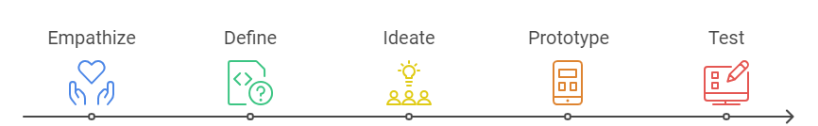
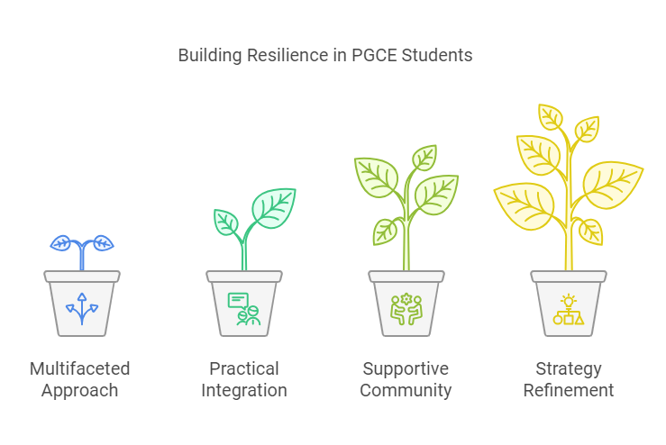
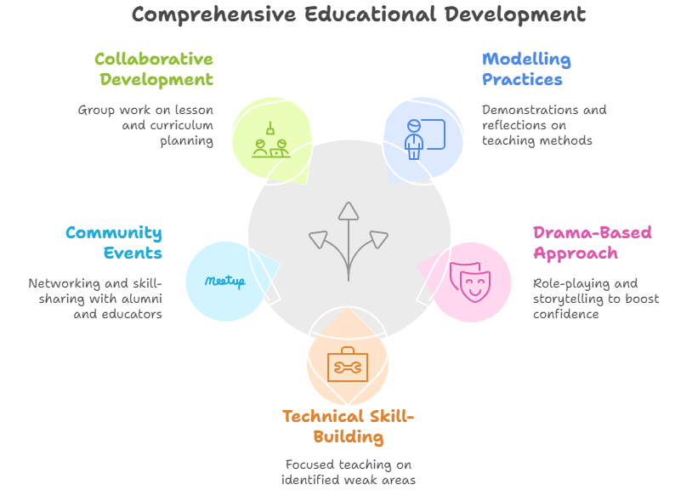
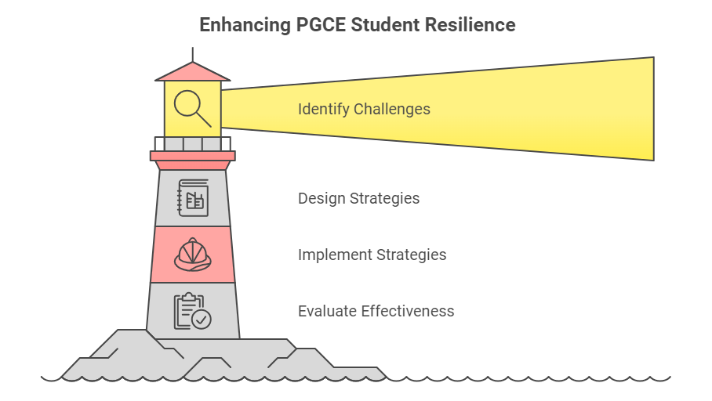
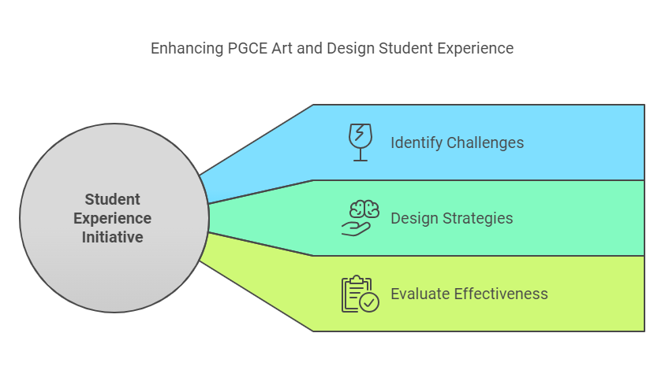
Collaborative Classrooms: Enhancing Resilience and Adaptability in PGCE Art and Design Educators.
ulster.ac.uk
Introduction
Methods
Conclusions
This study examines a 2024 student experience initiative within Ulster University's PGCE Art and Design program, using design thinking to improve teaching and learning. Design thinking is appropriate for this study as the model's iterative nature is effective in addressing the complex challenges of resilience and adaptability. It addresses challenges in student teacher confidence and adaptability during school placement transitions, aligning with the university's goals of enhancing employability and fostering collaboration.
  A Design Thinking approach was deemed relevant as it fosters creative problem-solving and adaptability by encouraging innovative strategies for inclusive and dynamic teaching.
  1. Empathize: questionnaires and group discussions.
  2. Define: Development of problem statement.
  3. Ideate: Generation of solutions through collaborative brainstorming, including role-playing, experiential learning, reflective practice, mentorship, and diversity training.
  4. Prototype: Development of top 5 solutions, including modelling effective practices, drama-based approaches, technical skill-building, community learning events, and collaborative resource development.
  5. Test: student feedback and refinement.
1. A multifaceted approach to develop resilience
and adaptability among PGCE students.
2. The integration of practical skills workshops, role-playing, and collaborative events proved beneficial in enhancing student teachers' confidence and pedagogical knowledge.
3. The findings support creating a supportive community and fostering CPG.
Future ideas: refine and scale these strategies to ensure they meet the evolving needs of student teachers using a second and third iteration.
Objectives
1. Identify the primary challenges faced by PGCE Art and Design students in developing resilience and adaptability.
2. Analyse how practical skills and pedagogical knowledge can be enhanced to improve student teachers' confidence.
3. Evaluate strategies that can be implemented to support the development of resilience and adaptability in pre-service teachers.
Results
The presenting author has no financial conflicts of interest to disclose concerning this poster.
Author: Franz Hoeritzauer: f.hoeritzauer@ulster.ac.uk : Room I224, Cromore Road,
Coleraine, BT52 1SA, Northern Ireland.
References
Beltman, S., Mansfield, C. and Price, A. (2011). Resilience in Teachers: A Review of Literature. Educational Research Review, 6(3), pp.185-207.
Fischetti, J., Smith, R. and Rogers, P. (2022). Role-Playing and Simulation in Teacher Education. Journal of Educational Innovation, 35(1), pp.45-60.
Lee, S. and Park, S. (2017). Design Thinking in Education: A Conceptual Framework. International Journal of Educational Research, 82, pp.120-130.
Castro, A.J., Kelly, J. and Shih, M. (2012). Building Teacher Resilience: Key Issues and Challenges. Teaching and Teacher Education, 28(4), pp.677-686.
Nolan, A. and Molla, T. (2017). Confidence and Competence in the Early Career Teacher. Australian Journal of Teacher Education, 42(5), pp.1-17.
Slate, E. (2023). Enhancing Graduate Employability: Strategic Priorities of Ulster University. Ulster University Publications.

