Slide 1

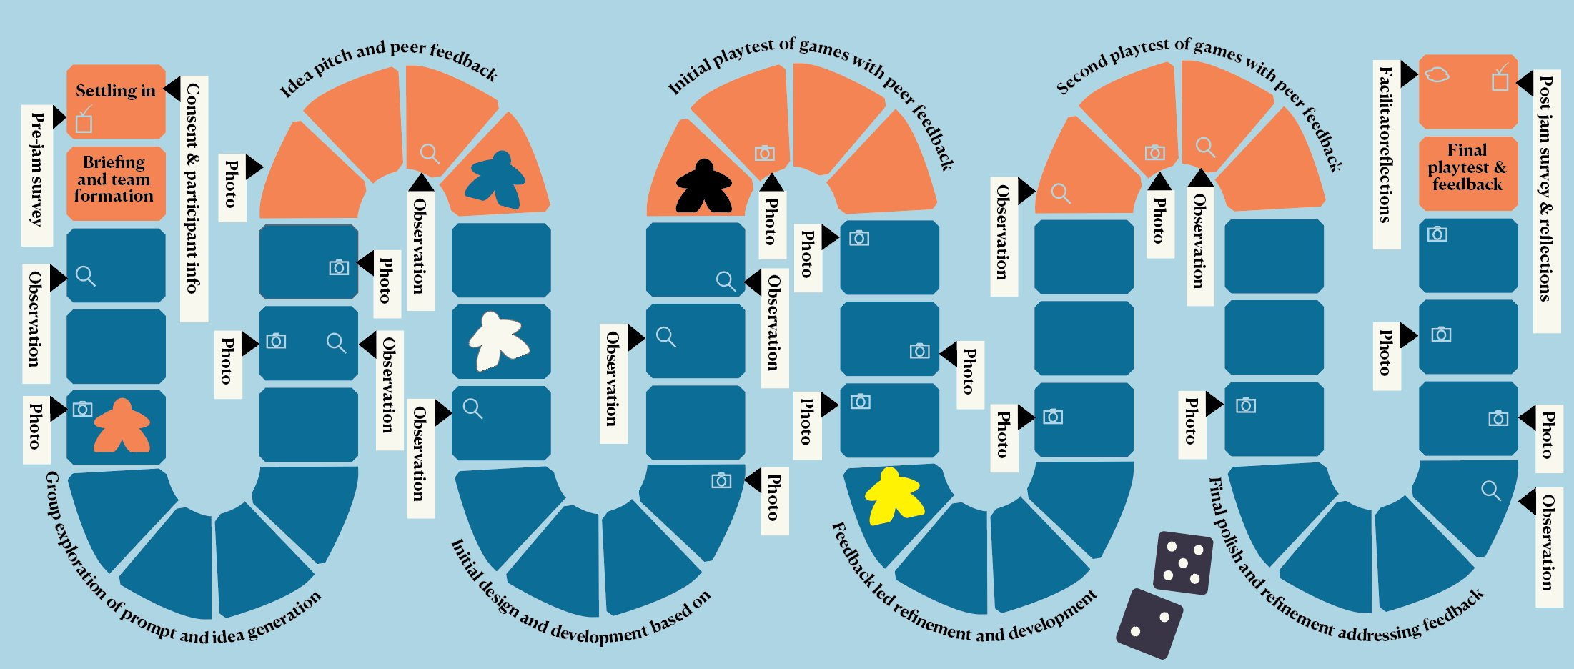
Data Collection for Educational Game Jams
Joe MacLeod-Iredale
Manchester Metropolitan University
Introduction & Objectives
Methods of Data Collection
Findings
Conclusions
Context? Six game jams have been run to collect data on their value as a teaching tool, exposing students to peer feedback-led cycles of iterative improvement.
Research intent? To collect both quantitative and qualitative data to allow a mixed methodological analysis of the efficacy of game jams as a creative HE teaching tool.
Purpose? This poster outlines the data collection methods employed and reflects on their effectiveness.
What is a game jam? A game jam is a time-limited non-competitive group game-making activity.
Institutions? Manchester School of Art, MMU, funded by North West Consortium Doctoral Training Partnership.
Pre-jam & post-jam surveys: Selected as it provided easily manipulable qualitative and quantitative data in an efficient manner, Collecting demographic information, experience with analogue games, card sorting to assess attitudes to design processes, repeated after, and & post-jam reflective writing.
Observations: Facilitator observations about the participants’ game-making, engagement, and anything else worthy of note.
Photographs: Of the games being developed and tested.
Game analysis: A short analysis of the games produced to capture their ‘essence’.
Facilitator reflections: After each session, the facilitator reflected on memories, feelings, frustrations etc.
Numbers: 6 jams have enabled 54 participants to produce 20 games.
Thematic analysis: qualitative data has produced 874 references across 52 codes that coalesced into 4 themes.
Quantitative data: 62 pre-jam & 32 post-jam surveys include cards sorts and demographics.
Quality: Attrition is a challenge and has rendered some pre-jam surveys unusable.
Larger groups: challenging to facilitate whilst gathering sufficiently detailed data.
Small groups: Easy to over-facilitate smaller groups and influence the games produced.
Reflections: Prompt reflective writing has been invaluable to subsequent write-up.
Engagement levels: extremely high, 'fun' was prevalent in post-jam feedback.
Working with others: Issues and opportunities of group working .
Peer feedback: Giving and receiving peer feedback in an intense creative setting.
Experiencing iteration: Benefits of rapid cyclic iterative testing and improvement.
Practicalities of game making: The issues encountered in running game jams in HE.
Effortless education: 'Learning through play' for adults and learning without it feeling like work.
Quantitative data: +ve attitudinal shifts towards iteration, testing, time management and the value of giving and receiving peer feedback, plus increased reported creativity.
These will be explored further in the author's PhD thesis and subsequent publications.
Key
references
from broader literature review:
Key References
From a broader literature review
Kultima, A. (2021) 'Negative Game Jam Experiences.' In ICGJ. Montreal, Canada, ACM, pp. 55–59.
Lave, J. and Wenger, E. (1991) Situated learning : legitimate peripheral participation. Learning in doing: social, cognitive, and computational perspectives. Cambridge, UK Cambridge University Press.
Macklin, C., Martin, J. and Dikkers, S. (2012) 'Planning your game jam: game design as a gateway drug.'
Orr, S. and Shreeve, A. (2019) Art and design pedagogy in higher education : knowledge, values and ambiguity in the creative curriculum. Routledge research in education. London: Routledge
Pirker, J., Kultima, A. and Gütl, C. (2016) 'The Value of Game Prototyping Projects for Students and Industry.' In Proceedings of the ICGJ. San Francisco, ACM, pp. 54–57
Vygotskiĭ, L. S. and Cole, M. (1978) Mind in society : the development of higher psychological processes. Cambridge, USA: Harvard University Press.
Disclosure Statement
Disclosure Statement: It is confirmed that all the materials included within this article represent the author's own work. Any citations or work that is paraphrased is included within the reference list. This article has not been previously published, nor is it being considered for publication elsewhere. The authors have no conflict of interest to declare in relation to this article.
Notes:
re

