Slide 1

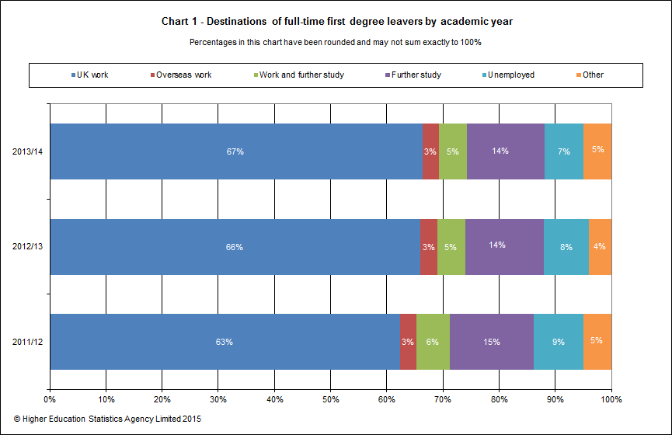
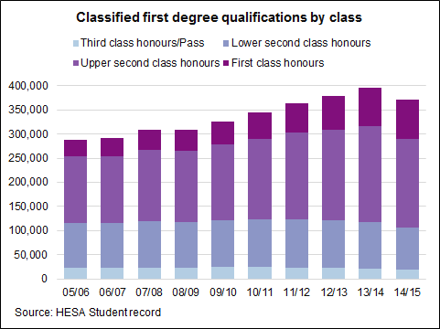
The Increasing Importance of Employability Skills
for University Graduates
Click For Audio
Rationale
Analytical Review of Findings
In my role as a Study Skills tutor, I embed employability skills (ES) such as critical thinking, report writing and written communication into each skills session. This research poster focuses upon the growing importance of said skills for graduates. Such skills have been defined as personal attributes, understandings and skills that can allow graduates to attain positions in their chosen professions (Yorke, 1999).
The issue is a contemporary one; when taking office Jo Johnson, Minister of Universities and Sciences, stated that his priority is to ensure that students ‘get the teaching they deserve’ and ‘employers get graduates with the skills they need’ (The Guardian, 2015). Furthermore, Chancellor of the Exchequer George Osborne, when detailing aspects of the proposed Teaching Excellence Framework, stated that universities with ‘high-quality teaching’ will be allowed to raise tuition fees in line with inflation from 2017-18 (The Times, 2015). This reflects a larger trend in higher education (HE), with the European Commission inferring that HE institutions should have curriculums that contain relevant, contemporary information that is applicable in the labour market (European Commission, 2013).
As a consequence of my own practice of utilising ES and the increasing importance placed upon them throughout Europe, they were selected for investigation in this project.
Consequently, from 1992 to 2013 the number of graduates in the population has risen from 17 to 38 percent (Office of National Statistics, 2016).
The findings suggest that the number of graduates in society has been rising gradually since the 1990’s, although the most recent statistics demonstrate a slight fall in the years 2014-2015. Whether this is indicative of a new trend will not be evident for several years, when more data has been collected. While 87% of graduates are currently employed, the number of graduates who are working within non-graduate roles has risen from 27% to 47% between 2001-2013. The ONS infers that this is a result of the growing numbers of graduates combined with fewer graduate positions. Consequently, there is a greater importance of equipping students with graduate skills, as they find themselves with more competition for fewer graduate roles.
In terms of what employers find desirable in graduate employees, the combined data suggests that in particular, communication skills, flexibility and motivation are particularly important. However, there are some differences between what employers suggest they are looking for in advertisements and what, when polled, they say is particularly desirable. For instance, there is a greater emphasis on organisational, analytical and commercial awareness qualities in the UOK data, whereas The Guardian data has a greater emphasis on accomplishments such as a degree, track record and qualifications. I infer that this could be a result of said advertisements being an initial barrier to entry when applying for a position, whereas the UOK data may reflect what employers would like to see evidenced at an interview stage. Also, worthy of note, is that not all graduate employers were polled by UOK, and so more data collection from a wider breadth of graduate employers could lead to more accurate and different data.
The graph to the left illustrates that graduates attaining jobs is gradually rising, with 75% of new graduates finding either graduate or non-graduate employment in 2013/14, and is supported by the findings of the Office of National Statistics (ONS) who found that overall 87 percent of graduates are currently employed (2016).
(Higher Education Statistics Agency, 2015)
However, from 2001 to 2013 graduates employed in non-graduate roles have risen from 27 to 47 percent. The ONS posit that that this may reflect the increasing number of graduates and a lower demand for graduate skills (2016).
Thusly it is increasingly important that graduates are aware of what employers are looking for. As such, The Guardian (2013) asked advertising agency Adzuna to find the top ten words or phrases that appear in job advertisements (see table, below left).
Methodology
This secondary research focuses on quantitative data regarding graduate employment (GE), as a means of contextualising the contemporary labour market university graduates are entering. Building upon this, the research then explores what skills employers are looking for in potential graduate employees, before considering if Staffordshire University resources and my practice reflect this. This secondary, quantitative approach to research was selected as a large breadth of data was required to accurately ascertain the current state of graduate employability and what qualities employers find desirable in the UK. A data sample of this size would not have been possible by conducting primary research.
Similarly, the University of Kent (UOK) (2016) asked leading employers including the BBC, Microsoft and Prospects what qualities they were looking for in employees (see table, below right)
Reflecting these findings, the Staffordshire University Careers Centre (SUCC) website and E-Coach include a wealth of sources to aid employability, including an Employability Skills Assessment checklist that reflects the above data specified by employers (Staffordshire University Careers Centre, 2011).
Conclusions and Recommendations
The UK government’s focus upon graduate employability is well founded, as there are an increasing numbers of graduates and fewer graduate jobs. Resultantly I, in my study skills role, must respond to this trend and the data concerning what employers find desirable. While my practice has a particular focus upon written communication, organisational and analytical employability skills, there is currently less focus on commercial awareness and drive/motivational skills. Resultantly, following this project I will research ways in which I can embed said employability attributes into my practice, in an effort to increase each student’s employability potential. I will also direct students to the SUCC resources and request the use of the Employability Skills checklist in sessions where appropriate. I would recommend a greater awareness of graduate employability and employer data amongst those working with higher education, and also for more research to take place regarding how best to embed and teach ES.
Findings
The Top Ten Phrases Found In Graduate Job Advertisements
Organised Communication Skills Motivated Qualified Flexible Degree Commitment Passionate Track Record Innovative
The Top Ten Qualities Leading Employers are Looking For
Verbal Communication Teamwork Commercial Awareness Analysing and Investigating Self-Motivation Drive Written Communication Planning and Organising Flexibility Time management
Telegraph reporters found while in that in 1992, universities received 171,000 applications, that in 2012, 544,000 students applied for a place (Rowley, 2013).
Data collated by The Higher Education Statistics Agency (HESA) (see right) shows a steady rise of students attaining a degree year on year from 2005 to 2014, before dropping slightly in 2015.
References
Benedictus, L. (2013) Top 10 Things Employers Are Looking for. [Online] Available from: http://www.theguardian.com/money/2013/apr/22/top-10-things-employers-looking-for. [Accessed: 8th June 2016]
European Commission. (2013) Improving the Quality of Teaching and Learning in Europe’s Higher Education Institutions. Brussels: European Commission. Higher Education Statistics Agency. (2015) Classified First Degree Qualifications by Class. Higher Education Statistics Agency. [Online Image] Available from: https://www.hesa.ac.uk/index.php?option=com_content&view=article&id=1897&Itemid=239 [Accessed: 2nd June 2016].
Higher Education Statistics Agency. (2015) Classified First Degree Qualifications by Class. Higher Education Statistics Agency. [Online Image] Available from: https://www.hesa.ac.uk/index.php?option=com_content&view=article&id=1897&Itemid=239 [Accessed: 2nd June 2016].
Higher Education Statistics Agency. (2015) Destinations of Full Time Degree Leavers by Academic Year. Higher Education Statistics Agency. [Online Image] Available from: https://www.hesa.ac.uk/sfr217#sfr217chart4. [Accessed: 2nd June 2016].
(Benedictus, 2013)
(University of Kent, 2016)
McGhee, P. (2015) Outstanding Higher Education Teaching Should Not Increase Students’ Debt. [Online] Available from: http://www.theguardian.com/education/2015/jul/21/higher-education-student-debt-teaching-excellence-framework-tef-jo-johnson. [Accessed: 1st June 2016].
Morgan, J. (2015) Budget 2015: Fees can Rise for Universities with ‘High-Quality Teaching’. [Online] Available from: https://www.timeshighereducation.com/news/osborne-signals-rise-9k-fee-cap-tef. [Accessed: 1st June 2016].
(Higher Education Statistics Agency, 2015)
Office for National Statistics. (2016) Graduates in the UK Labour Market. [Online] Available from: https://www.ons.gov.uk/employmentandlabourmarket/peopleinwork/employmentandemployeetypes/datasets/graduatesintheuklabourmarketreferencetables. [Accessed: 8th June 2016].
Office for National Statistics. (2016) Graduates in the UK Labour Market: 2013. [Online] Available from: https://www.ons.gov.uk/employmentandlabourmarket/peopleinwork/employmentandemployeetypes/datasets/graduatesintheuklabourmarketreferencetables. [Accessed: 8th June 2016].
Office for National Statistics. (2016) Percentage of graduates working in non-graduate roles in London and the UK: 2011 to 2015. [Online] Available from: https://www.ons.gov.uk/employmentandlabourmarket/peopleinwork/employmentandemployeetypes/adhocs/005742percentageofgraduatesworkinginnongraduaterolesinlondonandtheuk2011to2015. [Accessed: 8th June 2016]
Rowley, T. (2013) Top university, a great degree – but as for a job, dream on. [Online] Available from:
http://www.telegraph.co.uk/education/9977803/Top-university-a-great-degree-but-as-for-a-job-dream-on.html. [Accessed: 7th June 2016].
Staffordshire University Careers Centre. (2011) Employability Skills Assessment. [Online] Available from: http://www.staffs.ac.uk/support_depts/careers/esa.jsp. [Accessed: 12th June 2016]
Telegraph Staff. (2014) Employers Receive 39 Applications for Every Graduate Job. [Online] Available from: http://www.telegraph.co.uk/finance/jobs/10949825/Employers-receive-39-applications-for-every-graduate-job.html. [Accessed: 9th June 2016].
Word Count: 969
University of Kent. (2016) What are the top 10 Skills Employers Want? [Online] Available from: https://www.kent.ac.uk/careers/sk/top-ten-skills.htm. [Accessed: 9th June 2016].
Yorke, M. (1999) The Skills of Graduates: A Small Enterprise Perspective. In D. O’Reilly, L. Cunningham and S. Lester (eds.). Developing the Capable Practitioner: Professional Capability through Higher Education. London: Kogan Page.

