Slide 1
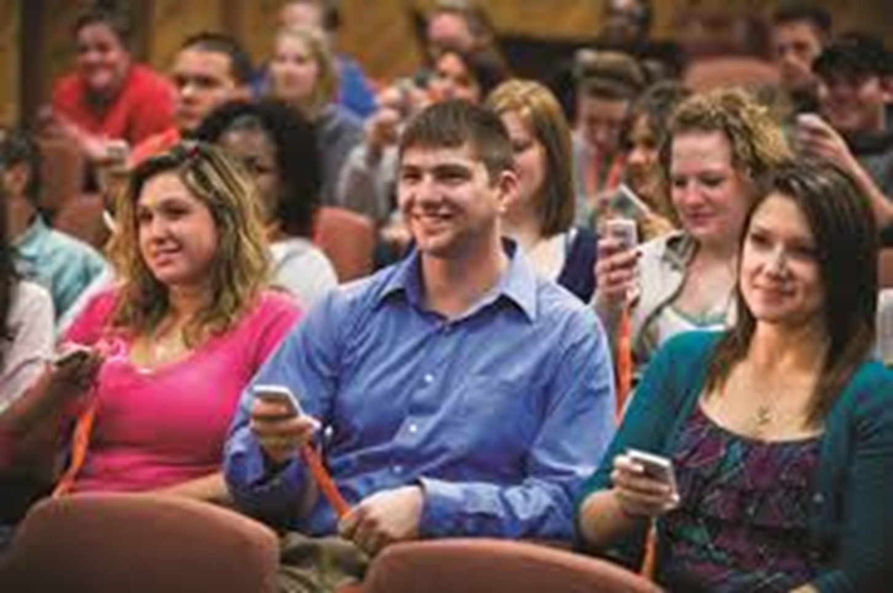

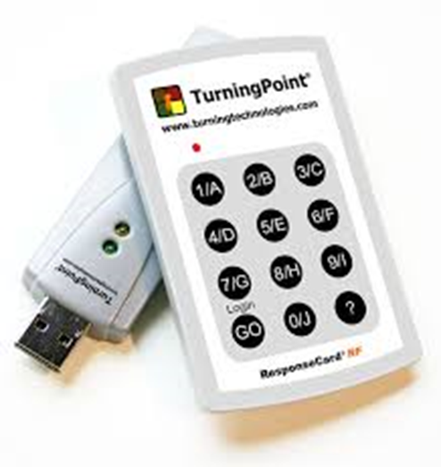
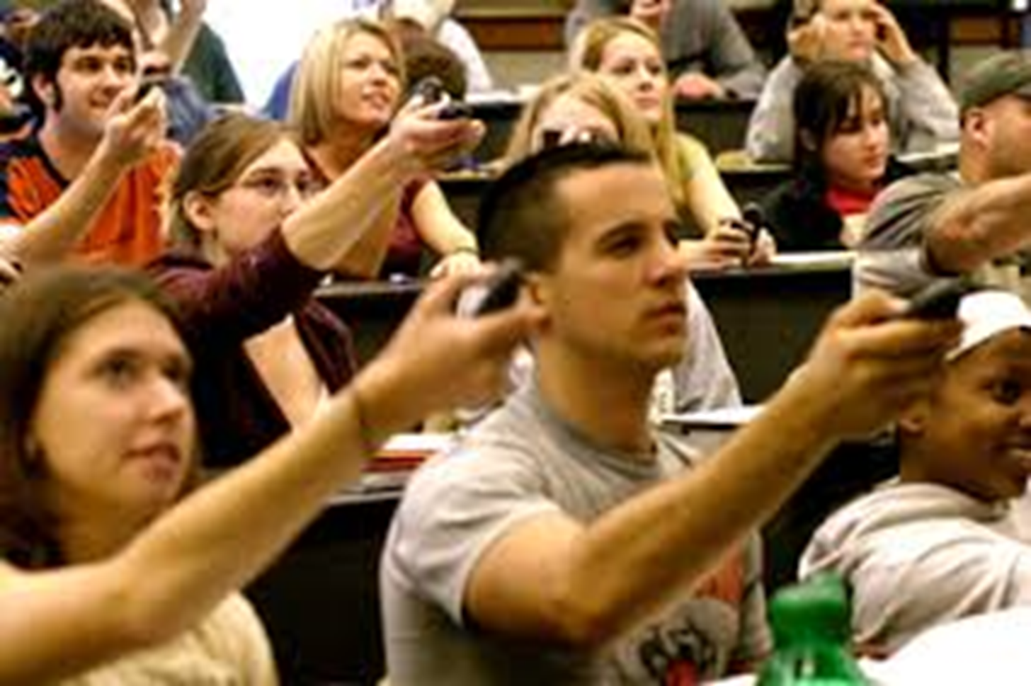
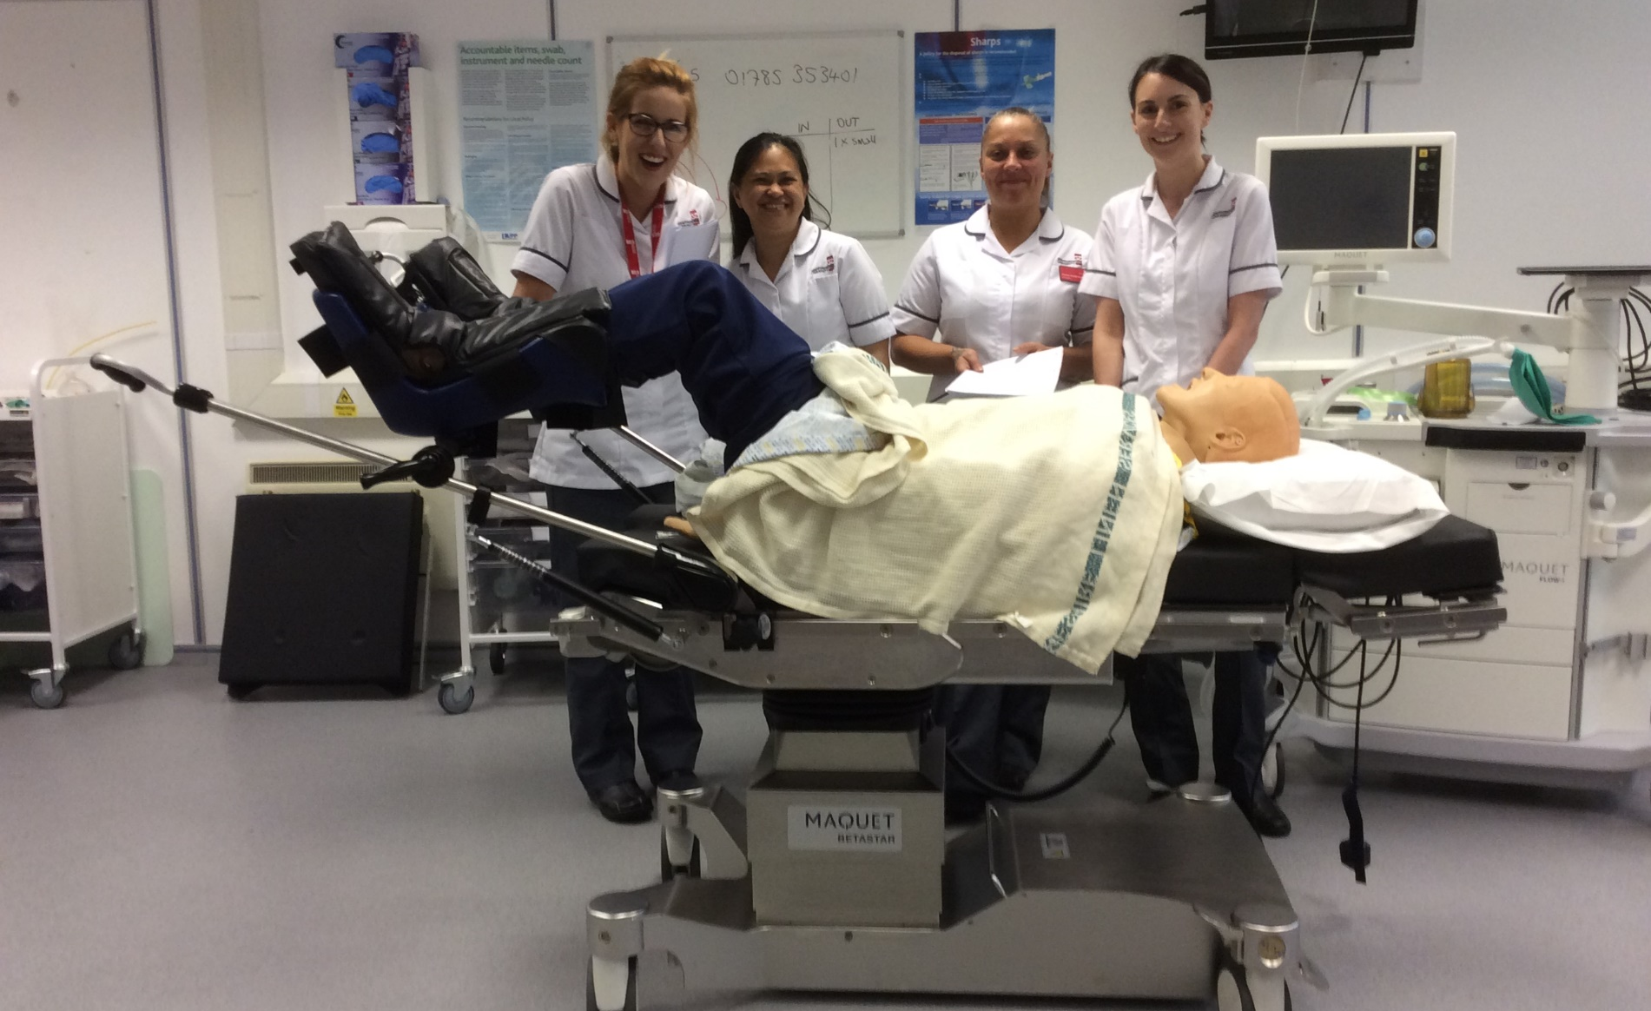
Clickers
Integrating technology into teaching and learning with interactive tools.
Fiona Cust. Staffordshire University, Faculty of Health Sciences.
INTRODUCTION
QUESTIONAIRE
RESULTS / FEEDBACK
CONCLUSION
The majority of students today are conversant with modern technology such as social media, the internet and emails – indeed, these are considered to be an integral part of daily life. Integrating these technologies into teaching and learning should assist and enhance the student learning experience providing flexibility, accessibility, and a student focused approach.
For learning to be an effective process there needs to be positive student engagement, constructive feedback and the focus of learning, as suggested by Biggs and Tang (2011), should be shifted from the lecturer to the student – the student ideally taking ownership of their learning. Many methods and styles of facilitating this type of learning have been explored over a number of years (Goldstein and Wallis 2015), however, one relatively easy yet effective means for engaging students in active learning appears to be the use of classroom response systems (clickers). When used appropriately the clicker can improve student learning outcomes in a number of ways (Goldstein 2013). They elicit discussion and enhance collaboration amongst students, they have proven to foster more honest responses to discussion forums, there is an increase in both student engagement and satisfaction within the classroom environment and they provide an instantaneous method of formative assessment (Briggs and Keyek-Franssen 2010). All of these positive factors are associated with best practices in learning.
A clicker is, simply, a student held handset for electronic feedback, voting, participation in class discussion, debate, and instant feedback. The benefits for the student include the maintaining of anonymity (if preferred), clarification as to whether they have understood the points being raised/discussed, and the opportunity to have a ‘voice’ without feeling intimidated or the fear of being ‘wrong’ (Bruff 2009).
Clearly this was a very mixed response and it would be impossible to accommodate all of these learning styles within a single lecture – therefore could a compromise be reached that would enable the majority (at least) of the group to gain the most from their lecture?
The questionnaire asked relatively straightforward questions about the students understanding of clickers, had they any experience of the system, and would they feel that this could be a useful tool to utilise within lectures? Results were very mixed but the majority of students did not feel that they would be 'comfortable using the system' and would worry about getting it 'all mixed up and incorrect.‘
A very informative presentation was then delivered about clickers, what they were, and how they would be used. The lecturer verified understanding by asking questions and using examples of academic institutions that were already utilising the system. Students were able to see a selection of clickers, hold them and be guided as to how to use them. They were encouraged to seek clarification about any areas they were unsure of. Written information about clickers was also given in handout form.
Small groups of 5 students were asked, after the clicker presentation had been delivered, (this took 45 minutes as was purposely kept concise and relatively focussed to allow for the group work) to prepare and deliver feedback to their peers about their perceptions of clickers and any positive/negative aspects that they may perceive. Presentations, as suggested by Cho (2007), are an excellent way of assessing a students knowledge and level of understanding. It encourages the student to prepare and think about/focus upon the topic that they are presenting. It also actively involves both their peer group and their lecturer.
Guidelines were provided about their feedback presentation as follows-
Following the presentation on the clicker system -
What is your understanding of a 'clicker'?
Would you feel confident to use this system?
What are the positive aspects?
What are the negative aspects?
Do you feel, as a group, that this would enhance your learning experience?
The presentations were delivered the following day - there were twenty students in the group and subsequently four presentations. Each presentation required each group member to present for three or four minutes on an individual basis to deliver their own perception of clickers and then the group concluded for the last two or three minutes. Presentations were, on average, twenty minutes long. Five minutes were allocated at the end of each presentation for questions from their peer group.
Each presentation was well planned, answered the points raised coherently and objectively, and every group were very positive about the utilisation of clickers.
Feedback included,
'initial anxieties about technology stuff but seems pretty straightforward',
'I would be encouraged to voice my opinions and wouldn't feel intimidated if my answer was incorrect',
'I would feel happier about taking part in group discussions as no one would know whose input it was',
'it would help me to clarify points within a lecture that I was uncertain about', 'I would probably be more honest about how I really felt about things'
'I would feel able to ask the lecturer questions about things that I was uncertain of without the fear of looking as if I was stupid', and
'it was really good to be able to see and hold a clicker as I could not visualise it in my head, that made it more real to me and addressed many of my concerns just by seeing the item.‘
There were very few negative aspects within the students presentations but the few that there were included,
'what if you really could not work out how to use it, you may feel very silly'
'how do you know for sure that you could maintain anonymity',
'are they cost effective, they seem quite expensive, who funds them?' and
'could the group become very frustrated if subject matter had to keep being revisited just because one class member did not understand? Could this lengthen lessons greatly?‘
Although these anxieties are very realistic they were addressed relatively easily by the lecturer. The students did feedback that they felt reassured by the answers and clarifications given and all of the students (n=20) felt much more confident about piloting the clickers.
It would appear from the presentations and feedback obtained from the group of students that this may potentially be a positive intervention. The group appeared to respond well towards the idea of using clickers, and from their comments did understand the concept and benefits of the system. Although there were some anxieties about them, these anxieties were discussed and the students appeared to be satisfied with any issues raised. The information given to the students was well planned, well researched and gave 'real life experiences' about the use of clickers. The presentations provided the students with the opportunity to convey their understanding of the systems and express their feelings about them. It also helped to clarify further a number of points. Meyer and Land (2006) suggest that when an area is really 'understood' it changes the way that the student perceives the subject matter and consequently how they behave towards it. Those who understand perform differently in what is described as 'performances of understanding'. Each topic/area has its own performance and, as Meyer and Land explain, it is a key concept to know what these are and how we manage them.
The clickers will be piloted with this particular cohort of students in September for a period of three months. However, a repeat questionnaire will be given after one month to ascertain the groups confidence and feelings about the system. Any issues/complexities will be addressed throughout the piloting period and an evaluation will be completed at the end of the three month trial. Results will be collated, and analysed, and a consideration will be made as to whether the clicker system is a useful resource to the programme.
REFERENCES
Biggs, J and Tang, C (2011) Teaching for Quality Learning at University 4th Edition. Maidenhead: Open University Press.
Bruff, D (2009) Teaching with classroom response systems: creating active learning environments. San Francisco, CA: Jossey-Bass.
Cho, P (2007) Enhancing teaching and learning in group projects through presentation. Enhancing Teaching and Learning through Assessment. Springer.
Goldstein, D (2013) What are they thinking? Best Practices for Classroom Response Systems. National Teaching and Learning Forum, 22, 5-6.
Goldstein, D and Wallis, P (2015) Clickers in the Classroom. Stylus Publishing.
Meyer, JHF and Land, R (2006) Overcoming barriers to student Understanding. London. Routledge.
STUDY
Although clickers are to be piloted from September 2016 within the Faculty of Health Sciences, it was decided to carry out a small study prior to their introduction. This study was carried out using a group of third year undergraduate children’s nursing students. These students come from a variety of backgrounds, are various ages, ethnicity, and have a number of different preferred learning styles. Prior to the introduction of a questionnaire about the utilisation of clickers, the students learning styles were explored. Responses included, enjoying peer support and working with colleagues, preferred to work independently, gained most from a mixture of both group interaction and sole learning, disliked group discussion and found the voicing of personal opinions/views both overwhelming and very intimidating and preferred to simply be ‘taught’ by the lecturer without any interaction from student group.
FURTHER INFORMATION
Fiona Cust – Fiona.cust@staffs.ac.uk
Senior Lecturer in Children’s Nursing
Staffordshire University

