Slide 1
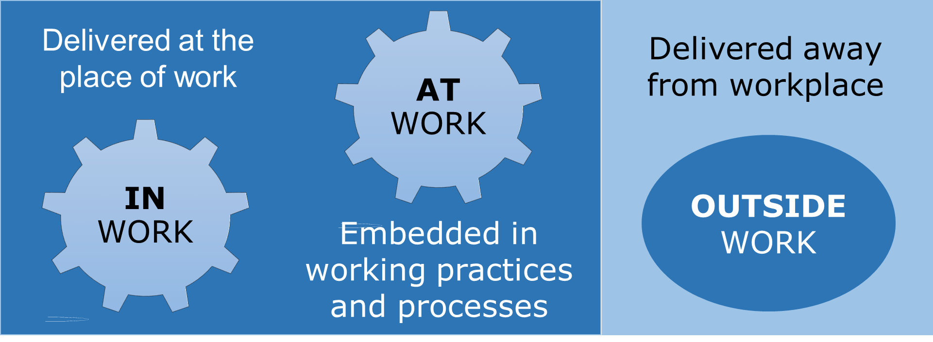
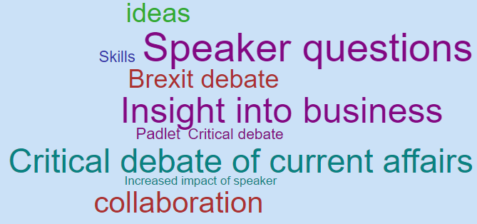





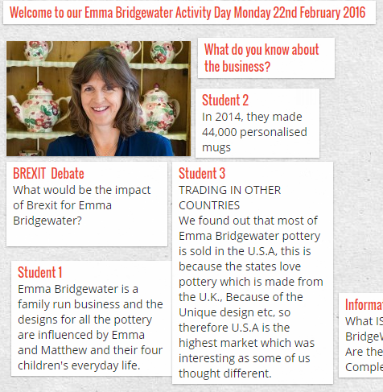



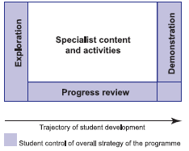







Can Online Technology Enhance Work Related Learning?
Mark Wordley, Staffordshire University, June 2016
Government, Employers and Students Demand Work Related Learning
Results
Strategies for Improvement
ONLINE DISCUSSION TOOLS
80% Foundation Students
WORK RELATED LEARNING
WORK RELATED LEARNING = EMPLOYABILITY
Weekly Padlet online
discussion – ‘What have I learned at work this week?’
Employability is a set of attributes, skills and knowledge that all labour market participants should possess to be effective in the workplace (CBI, 2007). Technology may provide greater opportunities to gain work based skills outside of work for Higher Education students.
Collaborate online to develop case studies of
extra-curricular activities
ACTIVE LEARNING
A Positive Approach to Employability
SELF MANAGEMENT
Students engaged in researching organisation and workplace.
Can online technology and innovation encourage a ‘positive approach’ to gaining employability skills and competences for higher education students?
‘I logged down my thoughts which helped my reflective skills because I had to think back to the experience’
Self-management
Thinking & problem solving
Working together & communication
Understanding business
WORK PORTFOLIO TO IMPROVE ENGAGEMENT
PDP to be developed into a professional work portfolio which will be highly valued by students
Using numbers effectively
Using language effectively
Using IT Effectively
UKCES (2009)
POSITIVE APPROACH Students enthusiastically and critically reflected on the workplace
Capability Envelope
Student focused
Tailored approach
39 aspects of
Employability digital audit
THE CAPABILITY ENVELOPE
POSITIVE APPROACH
‘…brought up some thoughts and feelings for example to not want to work at Amazon due to the robotic nature of the employee’
A positive approach is often referred to as having a ‘can do’ attitude (Young, 2014)
WORKING TOGETHER / COMMUNICATION
Diverse range of learning styles accommodated with students feeling comfortable contributing in online environment
Online collaborative and discussion tools were introduced in 2015/16 to evaluate their effect on the work related learning of foundation year university students. Local industry visits and supporting activities provided the environment to assess impacts against the UKCES requirements for employability.
THINKING/PROBLEM SOLVING
Online environment provided context for critical debate during industry visits
Online Technologies Evaluated
‘We had to reflect on what we saw and our experience using Padlet - a great way share my thoughts with fellow students’
DISCUSSION
DEVELOPMENT
‘Discovery days at Amazon & Emma Bridgwater helped me with my reflective skills’
Conclusion
Online tools have been used to successfully overcome student engagement issues with work related learning. The facilitation of discussion and reflection on work related activities have been found to be of significant value. The creation of coordinated learning activities supported by technology will improve engagement in work related learning. A more structured course based approach is needed to ensure that work based learning is effectively and consistently delivered by academic staff. The Capability Envelope and Employability Audit will be used to consider where online technology can support this approach.
MY PORTFOLIO
PERSONAL DEVELOPMENT PLAN
DISCUSSION BOARD
UNDERSTANDING BUSINESS
PDP demonstrated deep insight and reflection of guest entrepreneurs
‘DEAL BREAKERS’ FOR EMPLOYERS
Poor Communication Numeracy
or
Enthusiasm
Widely available
Free to students
Mobile compatible
Assessment
Teaching & Learning
POSITIVE APPROACH
PDP recorded high impact from industry guest speaker presentations, students highly motivated
REFERENCES: 1. ACTIVE INFORMATICS (2015) Employer Engagement Survey. Hampshire, Active Informatics Limited 2. CAREER DEVLOPMENT INSTITUTE (2014) Why does employer engagement matter? Stourbridge: CDI. 3. MARTIN R. (2008) Employability Skills Explored. Learning & Skills Network 4. UK COMMISSION FOR EMPLOYMENT AND SKILLS (2009) The Employability Challenge. London, TSO 5. WOOLF H., YORKE M. (2010) Guidance for the assessment of work based learning in Foundation degrees. Staffordshire: FDF. 6. YORKE, M. (2006) Employability in higher education: what it is – what it is not. Learning and Employability Series One. York: ESECT and HEA 7. YOUNG (2014) Enterprise for All [Online] Available from :www.gov.uk/government/enterprise-for-all-the-relevance-of-enterprise-in-education [Access 1st June 2016]
Method
Qualitative secondary research data sourced from 2015/16 Foundation students . Information taken from IPad video feedback, Padlet online discussions, Module online feedback and reflective feedback contained within students Personal Development Plans, used with permission. Relevant literature has been reviewed and cited. Research conducted during May/June 2016.
,
ASSESSMENT
Online summative assessment produced high quality reflective employability skills portfolio
Martin et al (2008)

