Slide 1


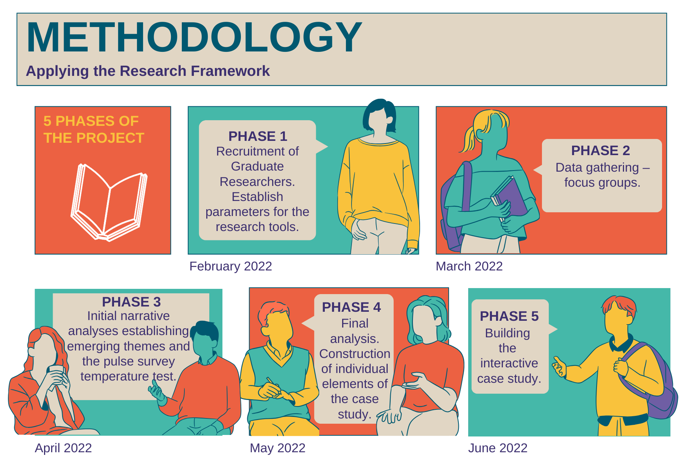
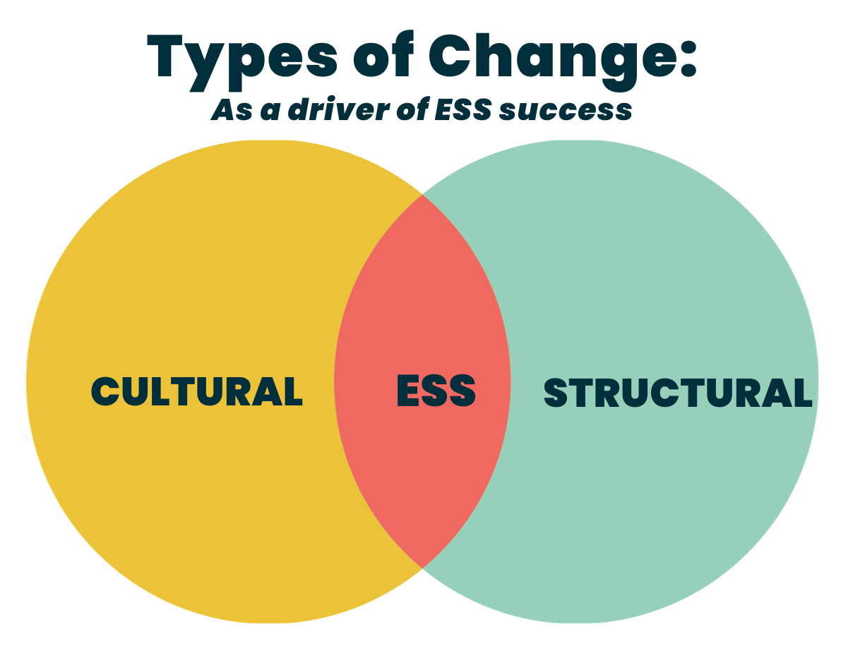
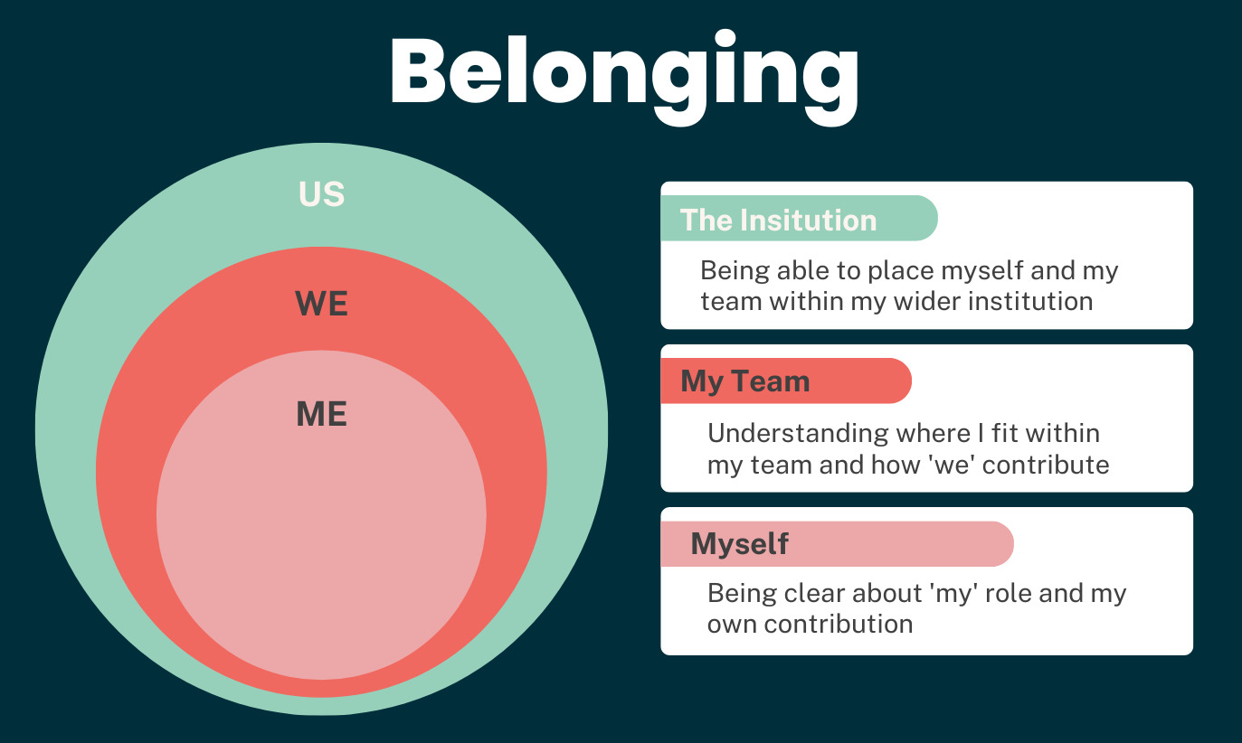
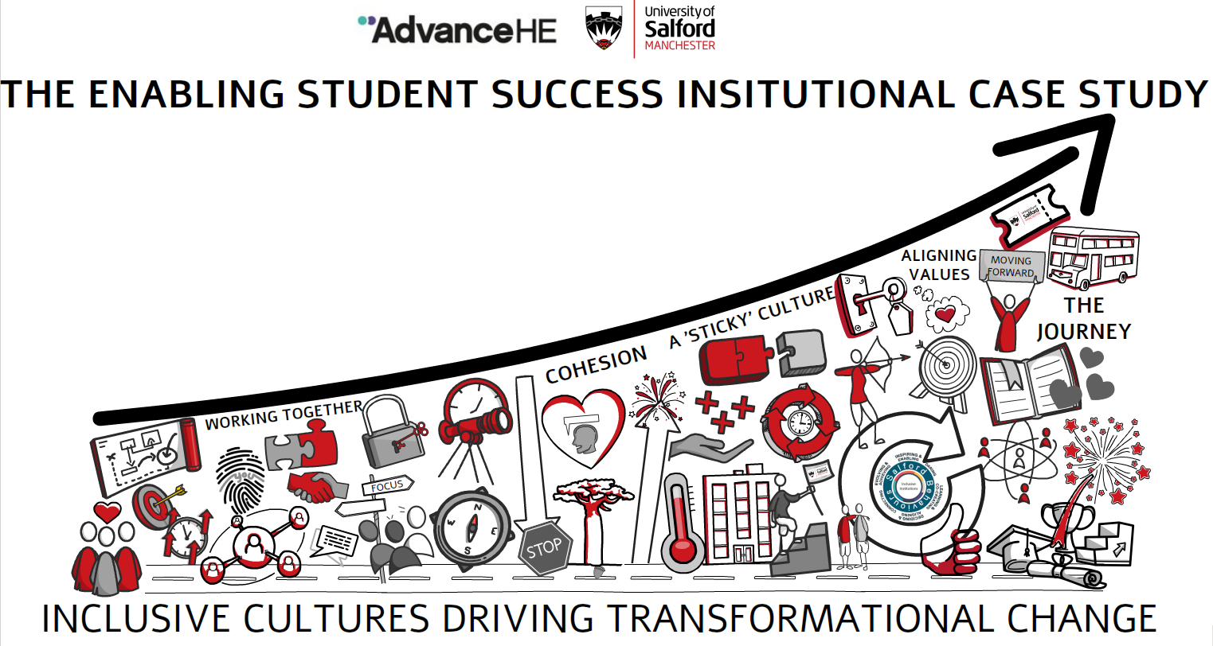
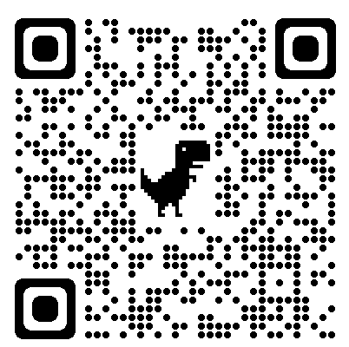

A gathering of creative outputs as a case study for transformational change
ABSTRACT
Eve Blezard, Jess Power and Davina Whitnall
Learning and Teaching Enhancement Centre, The University of Salford
RESULTS AND CONCLUSION
METHODS
LTEC@salford.ac.uk
@SalfordLTEC
Embark on a journey of cultural transformation at the University of Salford. Through innovative research methods and creative engagement, we explore how institutions can nurture evolving cultures. Discover diverse perspectives from four Academic Schools, measuring the profound impact on staff well-being, belonging, and career development. Join us in fostering inclusive, collaborative, and transparent cultures within higher education.
INTRODUCTION
Our research employed creative and participatory approaches, combining multiple data collection methods for a comprehensive understanding of cultural transformation.
Focus Groups: Engaging staff from diverse academic schools, these sessions fostered open discussions, yielding qualitative insights.
Pulse Survey: Widely distributed to capture diverse perceptions, this quantitative approach revealed trends related to cultural transformation.
Creative Outputs: Utilising visual storyboards, explainer videos, digital exhibitions, and reflective techniques, we encouraged open expression.
Thematic Analysis: We applied this analysis to the data, identifying strengths, barriers, and key values, ensuring a holistic understanding of cultural transformation
Our findings emphasise the importance of inclusive, collaborative, and transparent cultures, supported by creative approaches and outputs. These approaches facilitated deep engagement, while the outputs served as a platform for sharing and reflection, showcasing the potential for creativity to drive transformation.
Inclusive Solutions: Collaboration and open
communication were vital for embedding the Enabling Student Success (ESS) framework, fostering inclusivity, fairness, and transparency.
Student Experience: Staff's commitment to improving student outcomes and embracing diversity drove engagement in ESS.
Appreciation of Pre-existing Culture: An open, innovative, and inclusive culture positively impacted staff well-being and responses to change.
ESS as a Common Purpose: A single, strategic framework for student outcomes was seen as valuable, streamlining work and reducing workload.
Conclusions:
Inclusive, collaborative, and transparent cultures are crucial for successful transformation.
Ten enablers offer guidance for fostering inclusive cultures.
Ongoing cultural transformation requires understanding lived experiences and pre-existing cultures.
Creative approaches enrich institutional culture, supporting ongoing inclusivity and excellence.
Our study explores the transformative journey at the University of Salford, distinguishing between 'creative approaches'—our participatory methodologies—and 'creative outputs,' the tangible results of these methods. This exploration aims to understand and guide cultural transformation towards inclusivity and transparency. Aiming to examine the evolution of institutional culture, we investigate how an institution can foster a new culture, exploring the facilitation of cultural transformation across four diverse Academic Schools.
Our objectives:
Examining the processes that encourage cultural evolution within an institution.
Investigating variations in culture transformation facilitation among the four distinct Academic Schools.
Measuring the impact of this transformation on staff, assessing benefits such as enhanced well-being, a strengthened sense of belonging, increased value, and career development opportunities.
In this creative exploration, we unravel the intricate threads of cultural change, aiming to guide institutions towards more inclusive, collaborative, and transparent cultures.
KEY FINDINGS
KEY REFERENCES
Dyer, C (2018) Creating "sticky" culture: how to drive lasting behavioural change. Strategic HR Review.
Spatial (2022) SpatialChat. Available at: SpatialChat | Collaborative online workspace)
Whitnall, D (2020) ‘HR Excellence in Research Award: 'Vitae Policy and Practice event’ on
23 November 2021.
Strength Themes: "Inclusive solutions," "student experience," and "openness" highlighted the significance of collaboration, student-centricity, and open communication.
Barrier Themes: "Impact on staff" and "division" revealed concerns about workload, external pressures, and communication gaps.
Creative Engagement: Creative methods facilitated diverse perspectives and open dialogue among staff
Learn More at:
Use the QR Code to watch our project video
https://www.advance-he.ac.uk/news-and-views/enabling-student-success-case-study-university-salford
Disclosure Statement: It is confirmed that all the materials included within this article represent the author's own work. Any citations or work that is paraphrased is included within the reference list. This article has not been previously published, nor is it being considered for publication elsewhere. The authors have no conflict of interest to declare in relation to this article

