Slide 1
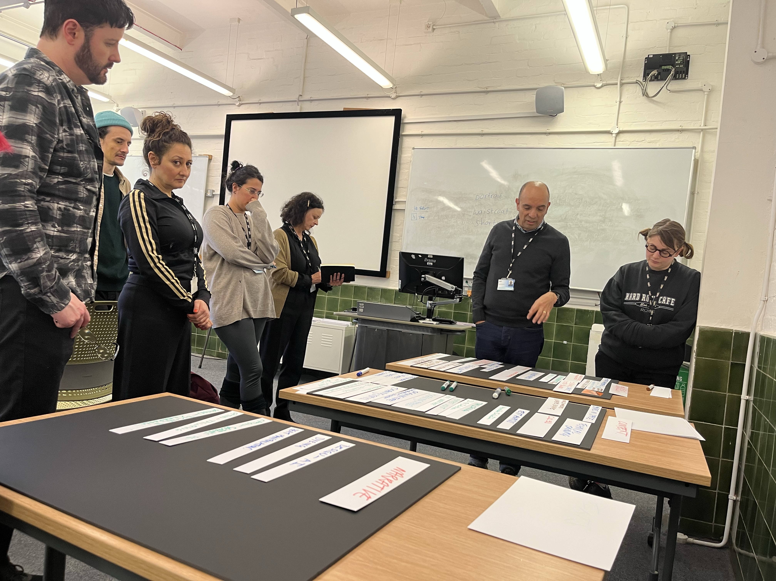
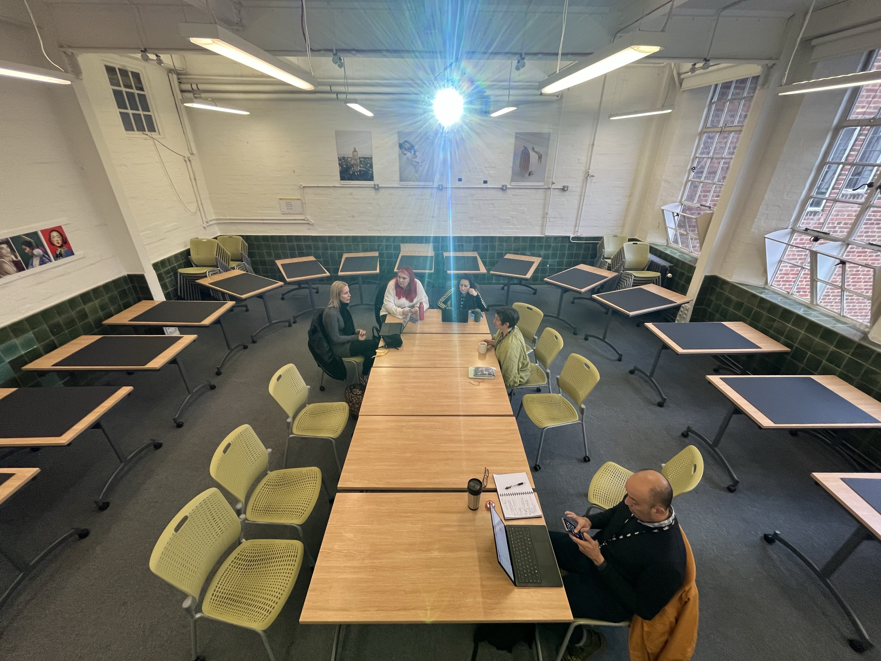
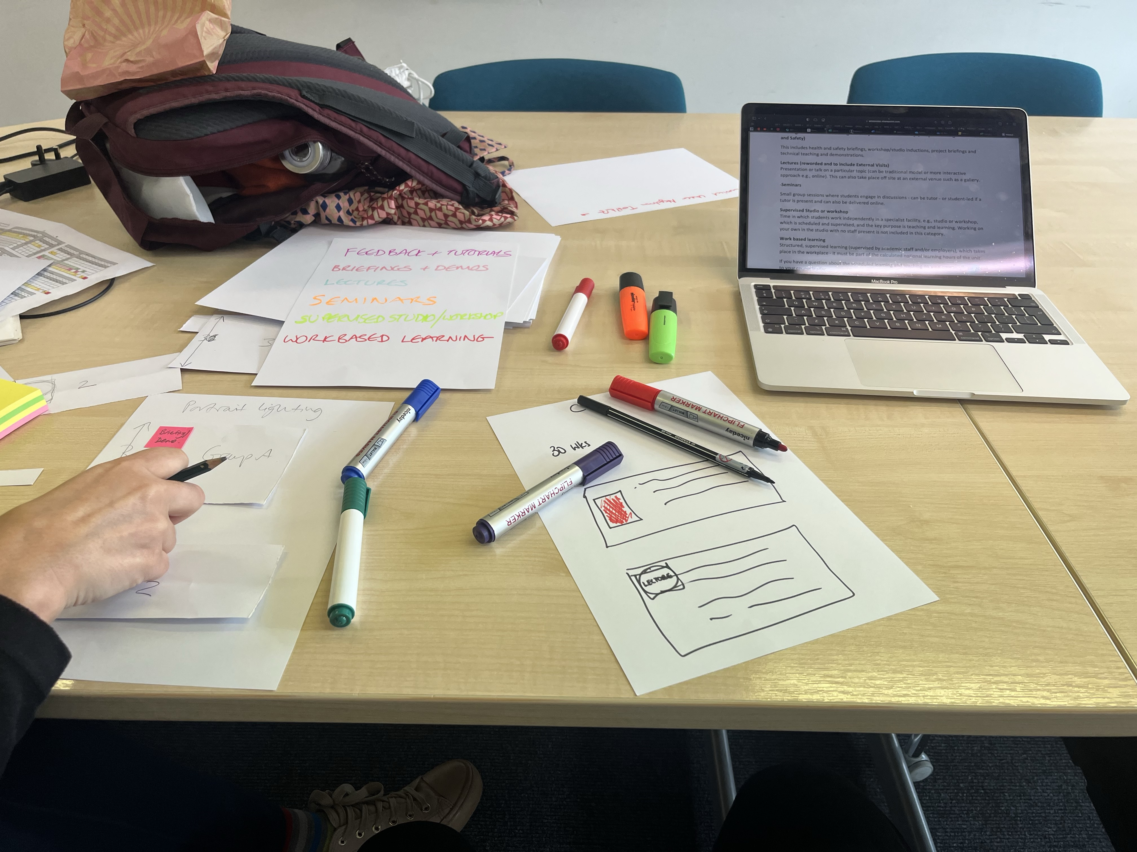
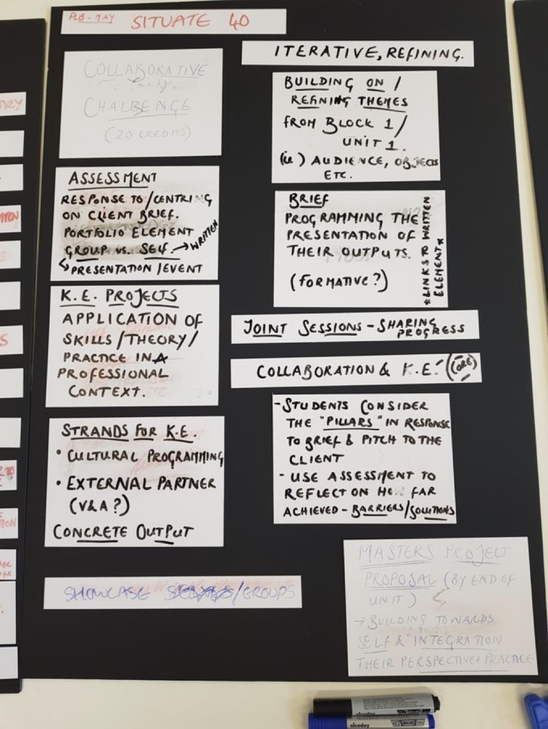
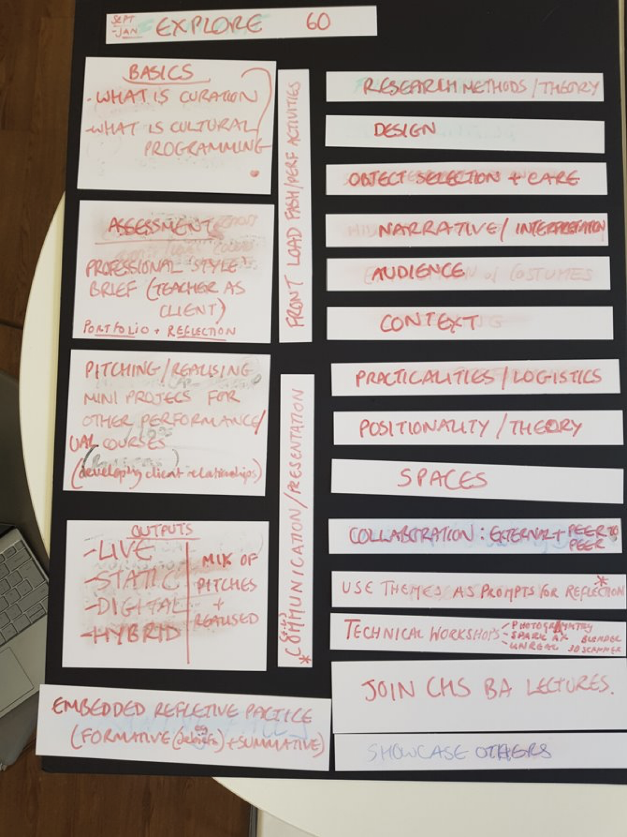
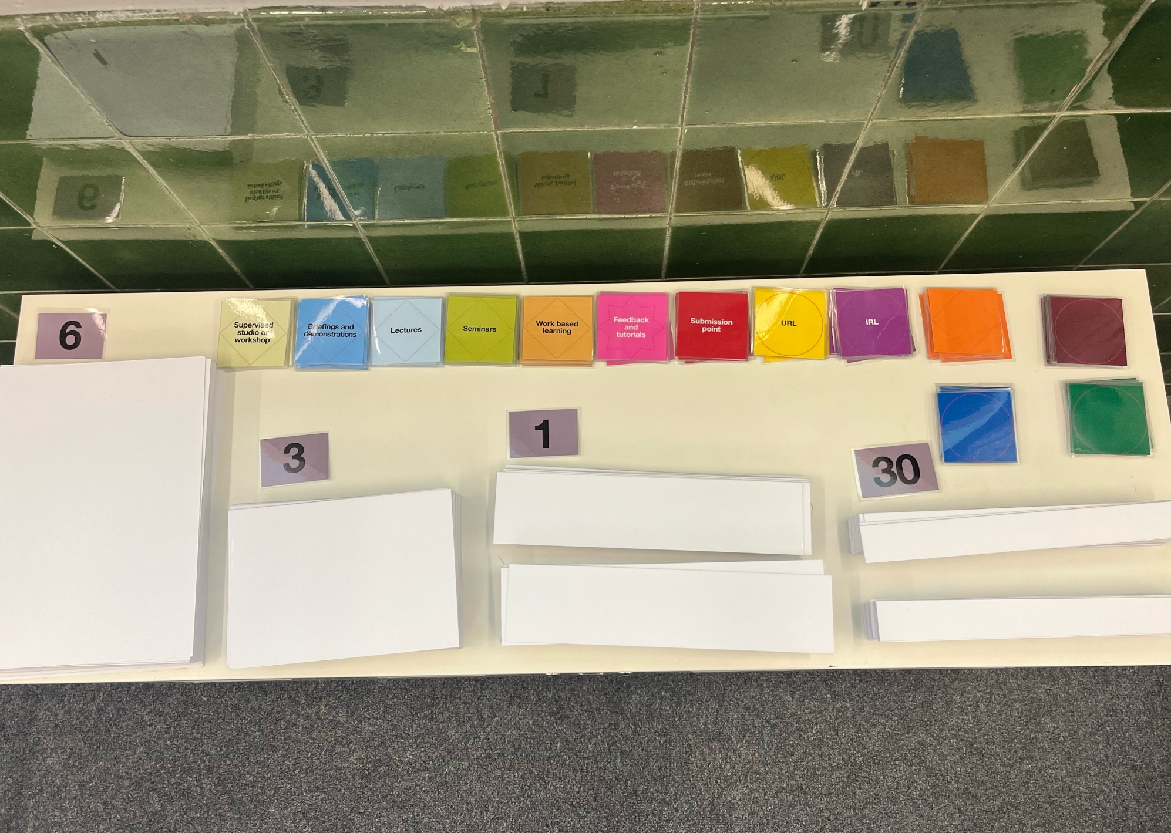
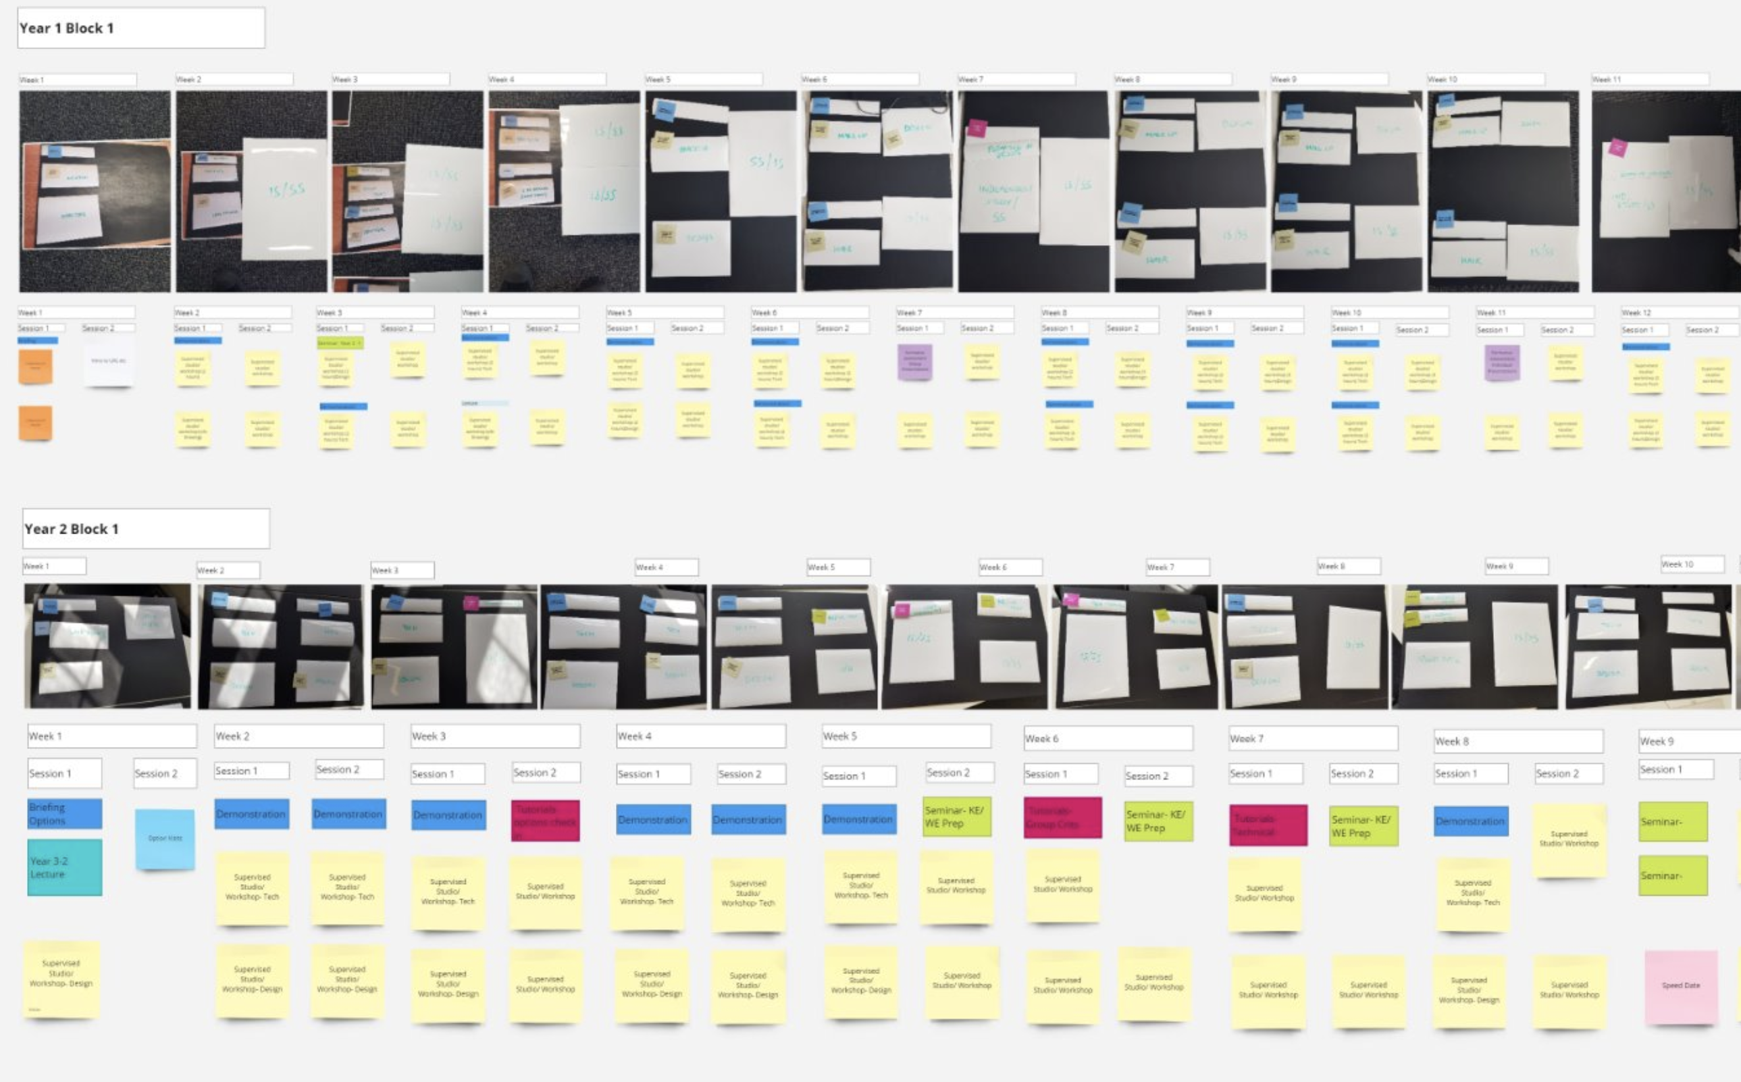
C
D
K
D
Curriculum Design & Delivery Kit
A flexible and hybrid toolkit for co-designing and delivering a curriculum
Introduction and objectives
Group work
Results
Methods
Conclusions
Summative Assessment
The design of this poster echoes the design of the kit and how it might be used. The size of these white tiles represent set contact time allocations.
Image 1: Playing with paper/card (shape, scale and relative proportioning of time) until the kit feels manageable in our hands (individual pieces) and walking round a room (overall).
Researcher observations:
Having pieces of information to place/move around animates conversation and is "psychologically freeing” (Team member).
Teams can walk around and see each other’s thinking / join ideas for cross-course collaborations and other opportunities.
Interpersonal dynamics within and across teams can be understood more deeply.
Physically thinking through and walking through the curriculum leads to clearer and quicker curriculum development and “helps to breakdown what the students are going to be getting” (Course Leader).
A synchronous physical and asynchronous digital iterative workflow develops reapprovals thinking in a performance-discipline-friendly way.
We believe that, through use of the kit, the gamification of curriculum design has enabled free thinking, leading to teams finding joy in and enthusiasm for curriculum development as part of the course renewal process: performance-making and curriculum development practices intertwined.
The researchers are still in the process of trialing and refining the kit, with the intention that it becomes an open access aid to curriculum design (or has other uses, as yet unknown).
Briefing
= 30 MINS
STAGE
1
Informed by devised theatre and physical performance practices, we centre physicality and movement in this exploration of curriculum design. We present a trialed, sustainable, visual, interactive, prototype kit: through the gamification of curriculum re/design, use of the kit becomes akin to the process of professional performance making.
STAGE
2
Image 2: Trialling the kit with the Performance Programme team during course renewal briefing so that the prototype was introduced and used from the outset.
Formative
Assessment
= 1 HOUR
Image 3: Further trialling around free use of kit piece time allocations to establish a more general student journey (course and year structure, unit lengths, headline content) before session-specific planning.
= 2 HOURS
Workshop
References & Bibliography
The Curriculum Design Kit (CDK) was developed to enable educators to think about pockets of student contact time and notional learning hours (credit points) in a fun, collaborative way, away from the psychological barriers of existing models and inherited norms. It consists of three sets of flexible components that are physical and digital, linear and non-linear, synchronous and asynchronous.
By first gathering in a physical space, then journeying through online platforms and considering new immersive environments, this research argues for a hybridity that cyclically informs iteration and innovation in pedagogy.
References & Bibliography
STAGE
3
Quality Assurance Agency for Higher Education (QAA) (2019) Subject Benchmark Statement Art and Design.
STAGE
4
Image 4: Following positive feedback, kit pieces developed to become magnetic on the back (for working vertically) and wipe clean on the front (for whiteboard markers) increasing the kit’s flexibility and making it reusable and sustainable.
Independent Study
= 3 HOURS
Future Potentials:
The kit is transferable to immersive environments.
The kit could also be used by/with students in co-created curriculum.
Further gamification could include timed course team competitions, points and prizes.
Walsh, Andrew and Clementson, Jonny (2017) Reasons to play in Higher Education. In: The Power of Play - Voices from the Play Community. CounterPlay, Aarhus, Denmark, pp. 181-187.
Tutorial
Image 5: Iterating physical work through digital platforms, such as Miro, teams continued to replicate, restructure, refine, colour code, annotate etc., bringing in wider team members to progress specific curriculum ideas.
STAGE
5
Wenger, Etienne (1998), Communities of Practice: Learning, Meaning, and Identity, Cambridge: Cambridge University Press.
= 2 HOURS
1
2
3
4
Nadia Malik, Programme Director: Performance & Andy Lee, Teaching Innovation Lead
London College of Fashion, University of the Arts London
5

