Slide 1
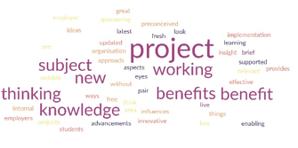
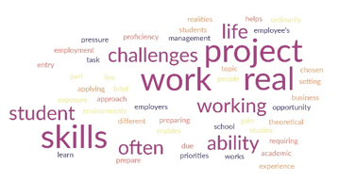
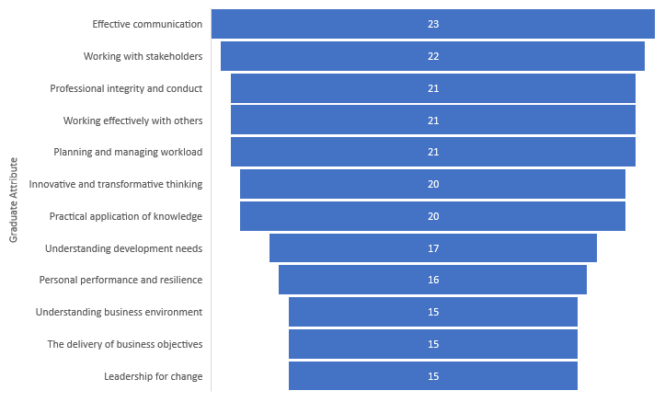
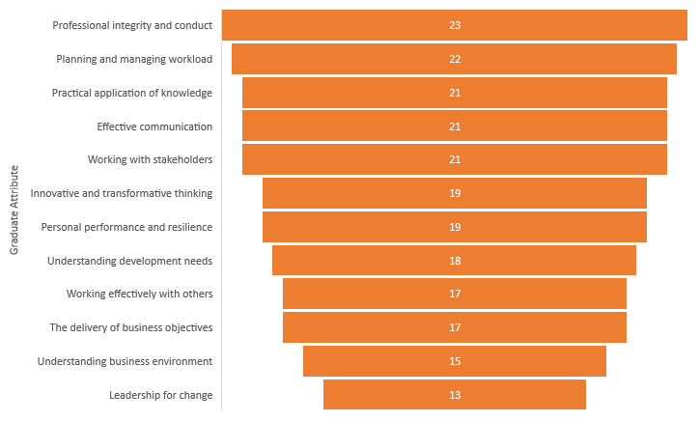
Industry Engagement and Authentic Assessment, their contribution to Lifewide Learning for Postgraduate students of professionally orientated disciplines. Carole Conroy c.conroy@salford.ac.uk Andrew Clark a.p.clark@salford.ac.uk School of Science, Engineering & Environment, University of Salford
Introduction
A tenet of constructive alignment is that it is what the learner does that makes them learn (Biggs & Tang, 2011). Encouraging learning, teaching, and assessment strategies that engage students, and working with employers to embed real-world learning into the curriculum is fundamental to the development of the identity of aspiring professionals. Furthermore, graduate employability is increasingly shifting “towards identity-based and relational accounts…with increasing alertness shown to specific context and local variations” (Dalrymple et al., 2021, p. 30). Structured opportunities for work-based learning, such as live-brief projects (QAA, 2018), are valued by Professional, Statutory & Regulatory Bodies (PSRBs) for the opportunities afforded for behavioural competency development such as stakeholder management, personal performance, communication and working with others. Moreover, they support innovation in Lifewide learning, assisting in the development of graduates for the world of work, enabling them to play a leading role in the formulation, implementation, and evaluation of policy and practice initiatives. The L7 Professional Practice module is delivered to cohorts of ~70 PGT students of professional programmes. The module starts with a series of workshops on performing in teams and interacting with clients. Administration of the Belbin Team Roles Self Perception Inventory assists students in understanding themselves, developing an awareness and ownership of an employability need (Reid, 2016; Succi & Canovi, 2020). Students then work as part of a team on a live-brief project relevant to their degree discipline. Authentic assessment is achieved through a portfolio and comprises a team project report, a team poster, and an individual reflective commentary of the project experience.
Results
This section presents an analysis of the qualitative narratives from the student voice (Table 1), complemented by the findings of the pilot survey (Figs. 1-3).
Table 1: Student Narrative review of Professional Practice module
Fig. 1 Employer Pilot Study total score of graduate attributes (a) relevance of graduate attributes to business environment (b) extent to which live brief project enables the development of graduate behaviours and attributes.
Note: Assigning a scale score where 1 is “not at all” and 5 is “extremely relevant/extremely so”.
Discussion
The ranking reveals a prioritisation by employers, suggesting attributes both highly sought-after by employers and seen to be developed in the live-brief project. Fig. 1 (a) and (b) show the intersectionality of four attributes, all ranked in the top five: effective communication, professional integrity and conduct, planning and managing workload, working with stakeholders. This reveals some incongruity with other employability literature (Cinique, 2016). Key themes emerging from the analysis of the student voice (Table 1) support these findings, particularly around self-realisation, action planning, and self-actualisation, transferrable skills, building confidence through problem-solving, and becoming a reflective practitioner.
The small pilot group sample size of employers (n=5 employers) is a limitation to the generalisability of the findings yet there is a clear synergy between the various stakeholders. Learning within live briefs is shown to be a social construct informed by HEIs, employers, PSRBs, and learners themselves, specific to context (Dalrymple et al., 2021).
Key Theme | Quotes
Path to Professional | “..a valuable insight into a real-life work situation…”; “…good at preparing us for real-world”; “…working with a real company…can help put into reality what can go wrong and how to deal with these situations.”; “Professional practice is one the best module for me this trimester. It has helped me and exposed me to business ideas…”
Self-realisation, action planning and self-actualisation | “…responsibility to the team motivated me to seek help to overcome my limitations…” “I learned …to produce quality work we …have to attend meetings… prepared with work that was planned…”; “I discovered the issues became opportunities where I discovered some strengths in myself…”; “Project Management techniques made it easier…..[aiding] the sequencing of activities against time and resources at hand…”; “I learned the value of foresight and contingency plans”
Transferrable skills | “…during the proofreading and critiquing our work, the skills I had acquired from LEAP workshops were especially helpful.”; “It cannot be doubted that this experience gave me the opportunity to develop skills in decision making, communication and team collaboration that could help me to be better prepared in a similar situation in future.”
Building confidence problem solving, becoming a reflective practitioner | “I started to have some ease, confidence and joy having spent about three weeks of the project time without understanding the work…”; “…this experience significantly helped to increase my confidence and communication skills”; “…I have learned from my reflective exercise better approaches to handling similar situations if they arise…in my workplace in the future”; “…a great tool for identifying my strengths and weaknesses.”
Conclusions and Recommendations for Further Research
These initial findings of the pilot study demonstrate that a live-brief space of learning can contribute to the domain of informal learning and personal development whilst involved in formal study, a key principle of Lifewide learning. Further exploration is required, implementing the survey within a larger sample population of employers. Greater insights may be obtained regarding further intersectionality which will inform learning, teaching and assessment strategies in live brief projects, particularly around creating awareness of an employability process need (by the learner) for development to occur.
Aims and Objectives
The study aims to investigate student and employer perceptions of the contribution of live-brief projects to Lifewide learning in professional contexts.
Objectives are to:
Explore the intersectionality of PSRB expectations of professional behaviours with graduate attributes as perceived by employers
Evaluate employer perception of the use of live-brief projects
Evaluate student learner perception of the use of live-brief projects
(a)
(b)
References
Biggs, J., and Tang, C. (2011). Teaching for Quality Learning at University, McGraw-Hill Education.
Cinque, M. (2016). “Lost in translation”. Soft Skills Development in European Countries. Tuning Journal for Higher Education, 3(2), 389-427. https://doi.org/10.18543/tjhe-3(2)-2016
Dalrymple, R., Macrae, A., Pal, M., Shipman, S. (2021). Employability: a review of the literature 2016-2021. Advance HE. https://www.advance-he.ac.uk/knowledge-hub/employability-review-literature-2016-2021
QAA. (2018). UK Quality Code for Higher Education: Advice and Guidance. Work-based Learning. https://www.qaa.ac.uk/the-quality-code/advice-and-guidance/work-based-learning
Reid, J. (2016). Redefining “Employability” as something to be achieved: Utilising Tronto’s conceptual framework of care to refocus the debate. Higher Education, Skills and Work-Based Learning, 6(1), 55-68. https://doi.org/10.1108/HESWBL-02-2015-0005
Succi, C., & Canovi, M. (2020) Soft skills to enhance graduate employability: comparing students and employers’ perceptions, Studies in Higher Education, 45:9, 1834-1847, https://doi.org/10.1080/03075079.2019.1585420
Methods
The pilot adopted a mixed methodology design approach, data was collected and synthesised from module evaluations and module performance statistics. A sample of student individual reflective commentaries was analysed to draw out a narrative of the student journey through the module learning experience. Analysis of PSRB accreditation curriculum statements with respect to behavioural attributes informed the design of a survey questionnaire. A pilot study of employers’ perceptions of the learning experience was undertaken involving a survey completed by a small sample of employers involved in co-designing and supporting live-briefs.
Fig. 2 Please tell us your views on the benefits of a live brief project for you as an employer?
Fig. 3 What do you think are the benefits of a live brief project to the student-learner?
Disclosure Statement
All materials included in the poster represent the authors’ own work and anything cited or paraphrased within the text is included in the reference list. This work has not been previously published nor is it being considered for publication elsewhere. There are no conflicts of interest that might have influenced the authors in reporting their findings completely and honestly.

