Slide 1
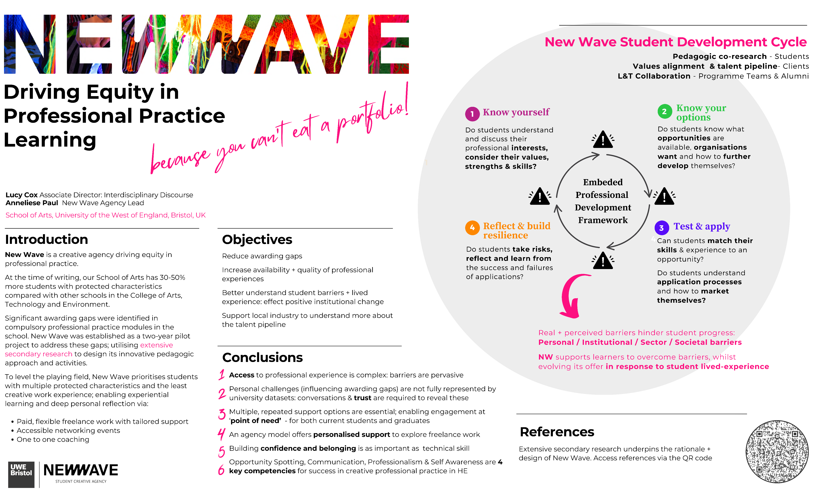
Disclosure Statement: All materials included in the poster represent the authors’ own work and anything cited or paraphrased within the text is included in the reference list. This work has not been previously published nor is it being considered for publication elsewhere. There are no conflicts of interest that might have influenced the authors in reporting their findings completely and honestly.
Contact:
Lucy2.cox@uwe.ac.uk
Anneliese.paul@uwe.ac.uk

