Slide 1
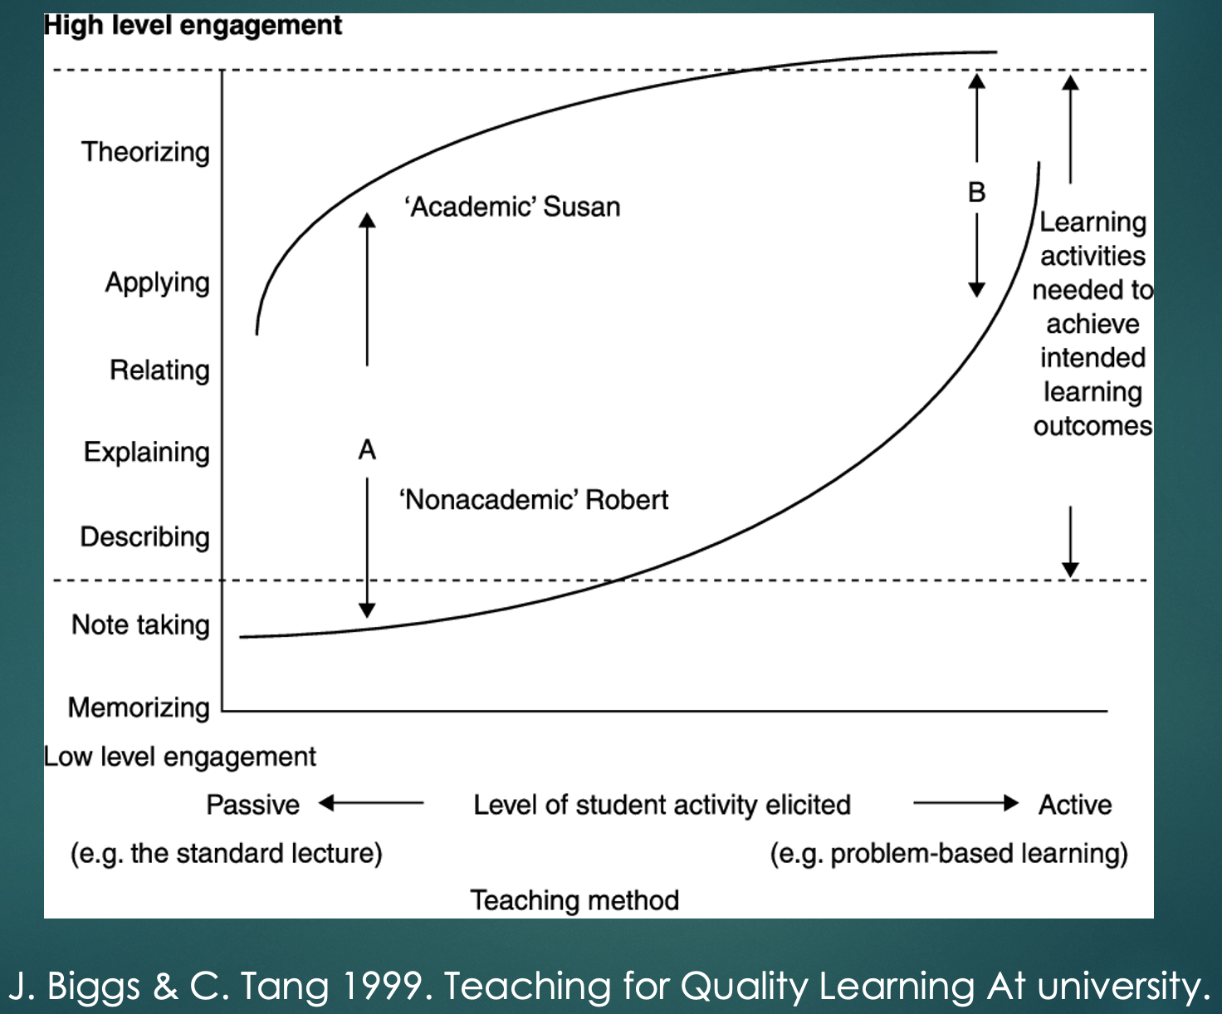
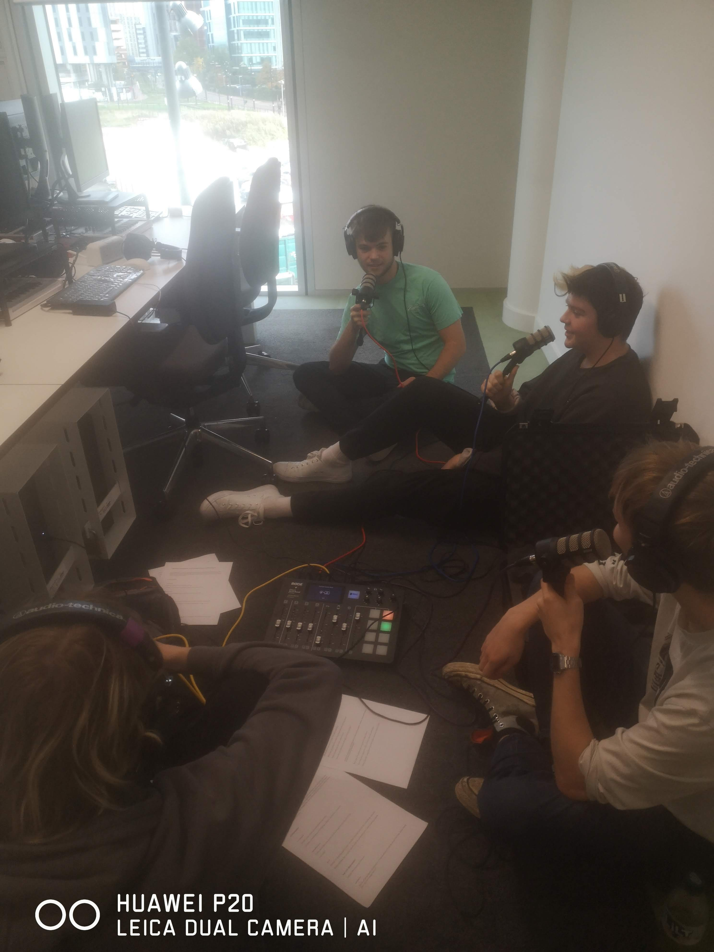
Podcasting for Engagement and Assessment .
Author: Adam Fowler A.J.Fowler@salford.ac.uk
School of Arts, Media and Creative Technologies, University of Salford
As in my own experience, and that of Professor Bull, the authors, in an online article, It’s Time for Academe to Take Podcasting Seriously, “have seen how podcasts can shift both teaching and research toward more dialogic, collaborative and creative forms of intellectual inquiry……..” and that it, “has proved to be a highly effective means of increasing engagement, deepening critical and analytic skills, and letting students learn via experience how information is transformed into knowledge” (Adams, et. al., 2021).
(100% attendance and participation by the first Creative Audio module cohort to submit this assessment as a group podcast). Future research will include the development of empirical means of measuring any improvement in critical analysis skills, and the enhancement of grades, as perceived in my own and others’ classes.
Recording a podcast (including group preparation) is a working example of Biggs and Tang’s ‘Student orientation, teaching method and level of engagement’ chart (fig 1.1 in Teaching for Quality Learning at University) where the gap in learning between ‘academic Susan’ and ‘non-academic Robert’ is reduced by teaching that is towards the ‘active’ end of their ‘teaching method continuum’ (Biggs and Tang, 2011).
Podcasting also encourages students to bring their own worldview into their learning as suggested by Moon’s constructionist view which, ‘focuses on the activities of the learner in making sense of her world’ and where Moon suggests that, ‘meaningfulness is a judgement to be made by the learner in the context of the sense of her cognitive structure (at that time)’ (Moon, 2004). Indeed, in this podcast review activity the learner constructs the meaningfulness as much as, if not more than, the teacher, allowing for assimilation of new learning into the existing ‘vast but flexible network of ideas and feelings with groups of more tightly linked ideas and feelings” (ibid). In this way, ‘Bricks can change other bricks or be changed by them” (ibid). In other areas of the School, I have facilitated the replacement of an exam with a group podcast assessment in the Contemporary Politics module led by Martin Bull, Professor of Politics. “[I]t was transformative in its effect on my students in relation to both their enthusiasm and learning abilities. I have rarely seen my students so engaged in an assessment, so enjoying it and learning from it. The learning, moreover, was in relation both to the substance of the task and in terms of developing their skill sets (use of technology, presenting work, team work etc. I was experimenting with this new form of assessment, using it instead of the usual examination. But it is now an integral part of my module, and an assessment I am looking forward to running each year” (Bull, 2023).
Introduction and Objectives
As a replacement for previous essay assessments, my students now use Rodecaster Pro podcasting kits to record audio critiques, as podcasts, of the work of professional audio producers. Such podcasting requires great consideration of ‘the other’ and thus encourages understanding and inclusivity, not just in the group dynamic during production but in the creation of accessible content which requires an authentic attempt to empathise with a particular audience.
“Ultimately, podcasts allow students and faculty to share their ideas with an audience beyond the classroom, imbuing their work with more meaning and purpose” (Adams et. al., 2021).
My objective is to develop a means of testing and verifying the degree to which:
engagement is increased, learning enhanced, and inclusivity promoted by the ethos of shared endeavour, a negotiated end purpose, and a specific listener in mind that podcasting engenders and requires.
the benefits can enhance inclusive learning in any discipline, beyond media courses.
My next step is to test this observed cross-discipline success by:
developing ways of supporting others to facilitate podcasting sessions, regardless of previous experience.
empirically assessing levels of engagement and learning by inviting module leaders across all schools to replace existing, relevant, written assessments with podcast recordings, and to compare results against previous data, including submission rates and grades.
developing ways of capturing student experience and levels of inclusion, equity and diversity.
developing rubrics for assessment and grading of podcasts to balance considerations of production quality and academic rigour.
seeking, or inaugurating, a network of those interested in podcasting in Higher Education in the UK to advance the underlying pedagogy. I have joined the Humanities Podcast Network’s Pedagogy Working Group in the United States and contributed to its open archive that “can serve as a cornerstone of evolving humanities pedagogy and scholarship” (Adams et. al., 2021). Their experience matches mine. I too have discovered that a sense of community is created amongst students and that there is an equity of opportunity to succeed, not least because the process, “instantly boosts the participation of students not prone to mastering the specific genre of the academic essay” (ibid). Moreover, I have seen how negotiation and quality of discourse improve, how analysis becomes more forensic, how the exposition of ideas becomes more structured and how, “(s)tudents learn how to construct an argument with regard to logic, tone and audience, and …..become more aware of the power of their voices to effect change” (ibid).
Methods
Portable and compact Rodecaster Pro kits, comprising a small mixer unit and four microphones and headphones, require only a power socket and a small amount of desk space. They can be loaded with audio clips (audio-visual archive, interview excerpts, music, readings etc.) to illustrate points or elicit discussions. Recordings are made to an SD card and can easily be transferred to computers or the cloud. More than one group can record simultaneously without detriment to student experience or audio quality.
In my Podcasting and Creative Audio classes, I scaffold the students’ technical confidence and analytical and critical skills during weekly practice discussions. I then provide feedback in the following session as preparation for the next recording. Students soon learn to work in their groups, independently of me. The final session, midway through the module, is an assessed review of the work of professionals, recorded as a podcast. At the end of a semester, the students also submit a podcast review of their own solo productions created as part of the module, which replaces a written critical evaluation.
Outside of my own discipline, I have set up the equipment for students, given an introductory tutorial and overseen a practice podcast discussion in one session, then overseen a podcast recording in the following session as a replacement of an existing essay assessment.
References
Adams et. al. (2021). It’s Time for Academe to Take Podcasting Seriously. Inside Higher Education, Retrieved from: https://www.insidehighered.com/advice/2021/09/28/how-harness-podcasting-teaching-and-scholarship-opinion
Biggs & Tang (2011). Teaching for Quality Learning at University. McGraw-Hill/Society for Research into Higher Education/Open University Press.
Moon (2004). A Handbook of Reflective and Experiential Learning: Theory and Practice. Routledge Falmer.
Bull (2023). Email correspondence with author.
Disclosure Statement: All the materials included within this article represent the author's work. Any citations or work that is paraphrased is included within the reference list. This article has not been previously published, nor is it being considered for publication elsewhere. The author has no conflict of interest to declare in relation to this article.
Results and Conclusions
In my own classes engagement has been transformed from lacklustre in the original solo written assessments (for instance, 66% participation in the final Creative Audio module cohort to be assessed this way) to virtually complete

