Slide 1
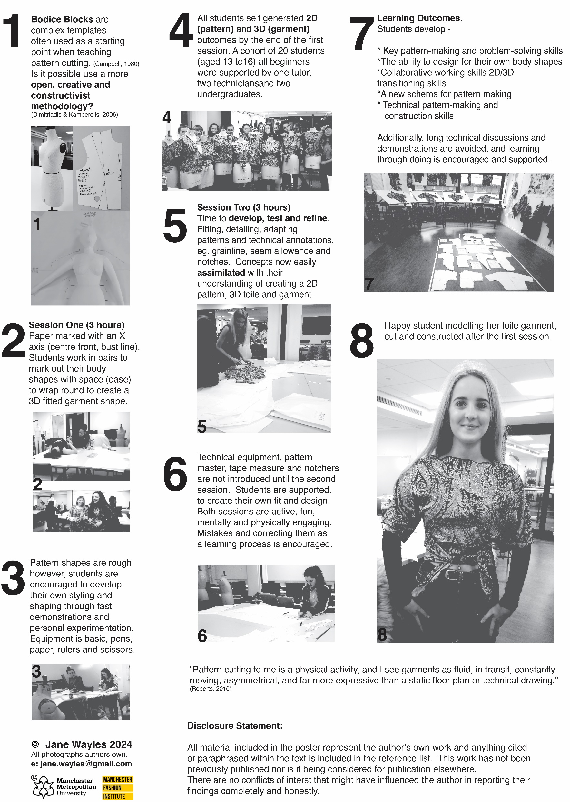
The Bodice Block Buster:
A Playful Revolution in Pattern Cutting
Author: Jane Wayles © 2025
Introduction and Objectives:
Two three-hour workshops were developed to experiment with disruptive teaching methods. The aim was to facilitate students’ use of 2D and 3D processes to produce successful 3D outcomes in a low tech, fun and inclusive setting. The goal was for participants to create a basic pattern and a garment designed around their own body. This was to be achieved within a three-hour timeframe with support provided throughout.
A second three-hour workshop focused on refining students’ skills and introducing technical terminology and markings, such as grainlines, notches, seam allowances, and the tools required to produce them, including pattern master and notchers.
Methods:
All students were novice pattern cutters with limited sewing skills.
Demonstration – This lasted no longer than 10 minutes and showed the basic method of tracing around the body, situated on a cross-marking.
Support – Verbal assistance was provided to students on their progress either one to one or in pairs.
Make Support – Technicians used industrial machines to sew and provided technical support (x4).
Reflection – Participants were encouraged to step back from their work to evaluate progress throughout the workshop.
Testing – Participants tried on their final garments to evaluate fit and function.
Results:
All participants pattern-cut and completed a fabric top they had designed and cut independently to fit their own bodies. Most successfully developed an understanding of technical construction terminology such as ease, fit, grain and how to mark body lines on their patterns to ensure fit of their garments. This was an active and busy workshop with high student engagement.
The second three-hour workshop enabled them to refine and develop their pattern shapes with technical markings and improve the fit of their garments. At this point it was possible to introduce more technical elements of pattern cutting as a skill as the students could fit it into their prior learning.
All students participating felt pride and ownership in the patterns and garments and were able to achieve a conceptual understanding of pattern cutting they can develop in the future.
Conclusion:
It is possible to move away from the bodice block as a pattern-cutting training template and indeed frees the students’ creativity and supports the development of confidence in their own creative process. Moving away from a size 12, generally Caucasian female body shape as a starting point also promotes a more inclusive and self-determined approach to pattern cutting. The participants designed and pattern cut for themselves rather than a pre-ordained template which often needs a great deal of technical explanation before it can be successfully utilised by a beginner. They understood the concepts of pattern cutting and using 2D and 3D processes to develop their patterns and garments in a fast, fun and holistic way.
Key References
Campbell, H., (1980). Designing Patterns: a fresh approach to pattern cutting. Cheltenham: Stanley Thornes (Publishers) Ltd.
Dimitriadis, G., and Kamberelis, G., (2006). Theory for Education. Great Britain: Routledge
Roberts, J., (2010) Free Cutting. [online] [Viewed 7 August 2024].
Available from: https://researchonline.rca.ac.uk/3060/1/FREE-CUTTING-Julian-Roberts.pdf
Artwork inspired by Bibliotheque Design’s poster for Dieter Rams (2009) Dieter Rams: Ten Principles [online] [Viewed 14 January 2025] Available from: https://bibliothequedesign.com/projects/dieter-rams-ten-principles

