Slide 1

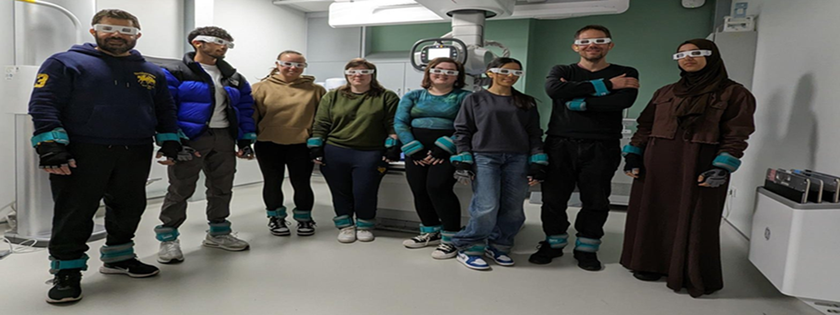
The student evaluation of a Research-informed Teaching activity using simulation
Robert Higgins r.n.higgins@salford.ac.uk School of Health & Society, University of Salford.
Introduction & Background
Aim
Findings
Linking research and teaching provides students with deep learning experiences, enhances the student experience of real-world issues and improves student self-efficacy (Elken & Wollscheid, 2016; Healey, 2007; Kruger, 2015).
Our Research-informed Teaching experience (RiTe) activity has been embedded within the Diagnostic Radiography curriculum since 2013 as part of a Level 5 (Year 2) Research Methods module. Outcomes are linked to research skill development and self-efficacy (Higgins et al., 2014).
We recently opened our new Medical Imaging Centre for teaching, learning and research. The Centre includes two clinical X-ray rooms. One of these rooms has been designed to be dementia-friendly for patient experience research in this area.
This also offered a new research-informed teaching activity with RiTe for students to plan and undertake a small research project where they designed a survey tool, to collect and analyse data that compared these two X-ray rooms. As part of the data collection students wore dementia simulation equipment to experience each room from the point of view of a person living with dementia and rate their experiences for comparison (Figure1 ).
Students were placed into small groups and undertook a mix of online teaching and on-campus group activities including piloting their survey tool and collecting data. RiTe ran over 4 weeks and culminated with a group presentation of their research and findings.
The aim of this study was to evaluate this new iteration of RiTe using simulation with a Year 2 (Level 5) BSc (Hons) Diagnostic Radiography cohort.
27 out of cohort of 71 students completed the online survey.
Overall student reaction was very positive with this new iteration of RiTe. Students strongly agreed that they felt the outcomes of RiTe had enhanced their knowledge of research, developed their self-efficacy with research skills and learning outcomes.
The use of simulation and being able to undertake the research as a group was also identified as a key element to the positive student experience and outcomes.
Figure 1: Year 2 students wearing dementia simulation equipment
Discussion
Research informed teaching focuses on enhancing the knowledge of students through research and developing their research skills.
Students agreed that that undertaking this new iteration of RiTe had enhanced their knowledge of research and self-efficacy with developing their research skills.
The research topic was also seen as relevant to their professional practice linked to person centred dementia care.
Evaluating the student experience not only provided feedback to ensure student outcomes were met but also a student voice to ensure that this new iteration of RiTe was engaging, inclusive and valued by students.
Method
The New World Kirkpatrick Model was the theoretical framework used to evaluate student reaction and self-efficacy (Kirkpatrick & Kirkpatrick, 2020).
An online 6-point Likert scale survey with free-text comments was used to collect student feedback.
Descriptive analysis was used to evaluate the survey data.
Next STEPS
Some students reported issues linked to concerns around work ethic / input into the activities were identified. It is proposed that more pre-group work activities will be introduced to try and overcome this.
A follow-up survey and focus group study will be used to further evaluate the student experience and self-efficacy of this version of RiTe with a new cohort of Level 5 students.
references
Elken, M. & Wollscheid, S. (2016). The relationship between research and education: typologies and indicators. Oslo: Nordic Institute for Studies in Innovation, Research and Education.
Healy, M. (2005). Linking research and teaching to benefit student learning. Journal of Geography in Higher Education, 29:2, 183-201.
Higgins R., Robinson, L. & Hogg, P. (2014). Integrating research informed teaching within an undergraduate diagnostic radiography curriculum: Results from a level 4 (year 1) student cohort. Radiography, 20:2, 100-106.
Kirkpatrick J. & Kirkpatrick W. (2021). An Introduction to the New World Kirkpatrick Model .Kirkpatrick Partners, LLC. Newnan, GA.
Krüger, S. (2015). Embedding Student Research in the Undergraduate Curriculum: Learning in the Field. Paper/poster presented at the Teaching and Learning Conference 2015, Liverpool John Moores University, 17-18 June.
Disclosure statement: All material included in the poster represent my own work, any ideas that are not my own have been referenced. The work has not previously been published and is not being considered elsewhere. There are no conflicts of interest.

